Slide 2
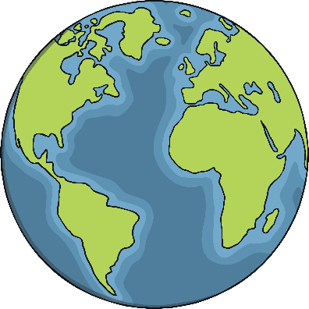
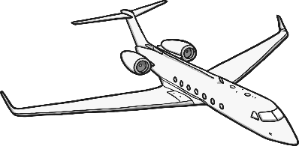
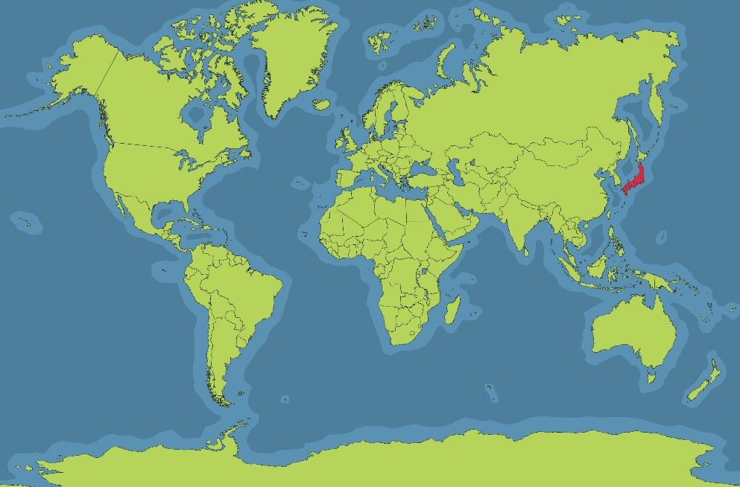
Where In the World is Japan?
Japan is an island nation in East Asia.
This means it is made up of 6852 islands.
The main islands are:
Honshu, Kyushu, Shikoku,
Hokkaido. They are also known
as the ‘home islands’.
It takes around 13 hours to get from the U.K to Japan.

Slide 3
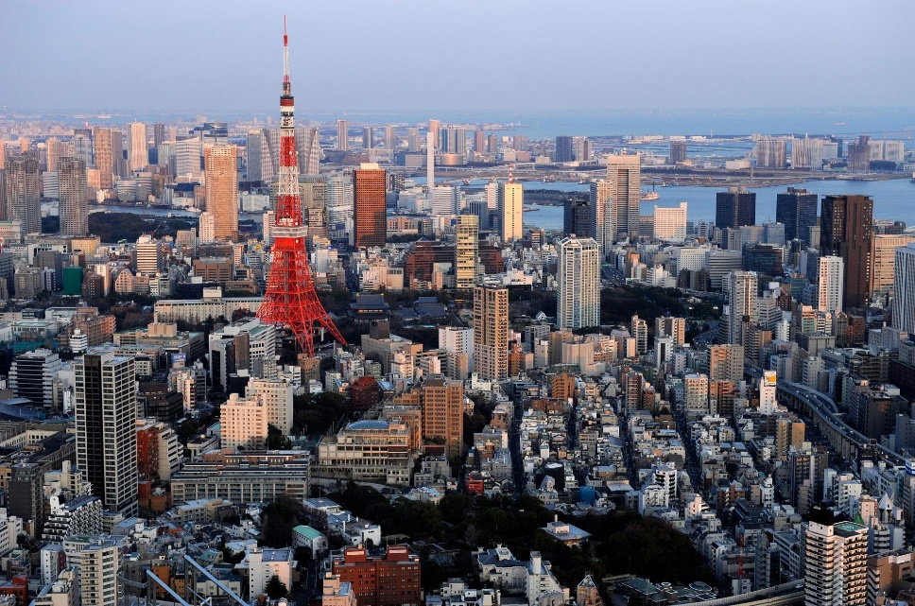
What is the Capital City?
Traditionally the capital city of Japan is where the Emperor lived.
From 794 to 1868, the Emperor lived in Heian-kyō,
which is now known as Kyoto.
After 1868, the Government of Japan and the Emperor moved to Tokyo.
The capital city of Japan is
This is on the island of Honshu.
Tokyo.
Emperor Akihito was the first emperor to retire in over
200 years.
The current emperor is Naruhito,
who took the position in May 2019
after his father Akihito retired.
Click on the name of the capital city to find out more.
Currently, more than 13 million
people live in Tokyo.

Slide 4
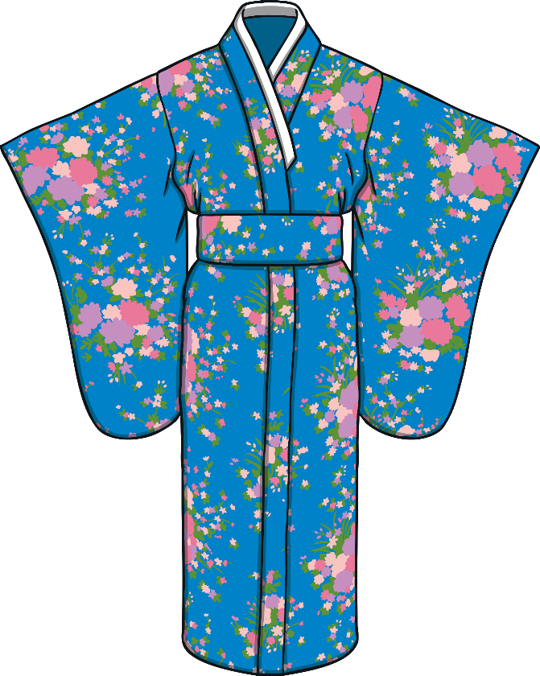
Japanese Clothing
In Japan there are two types of clothing. The first is western clothing which is like the clothing you might see people wearing in many countries.
The second is Japanese Wear
The kimono is traditional Japanese clothing.
Ki = to wear
Mono = object/ thing
They are made from silk and have long sleeves.
They are often worn for important festivals.
Young women wear kimonos with longer
sleeves. This shows that they are not married.

Slide 5
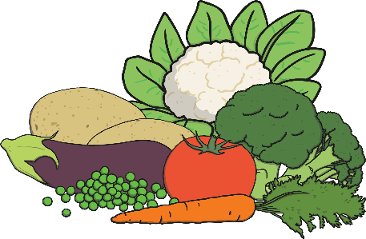
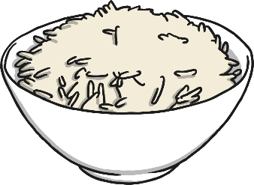
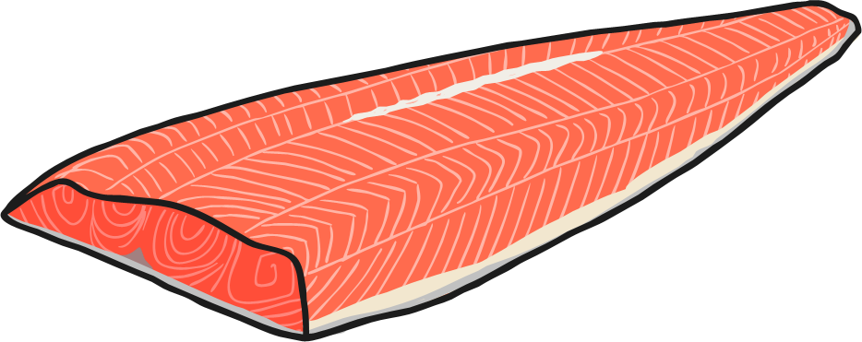
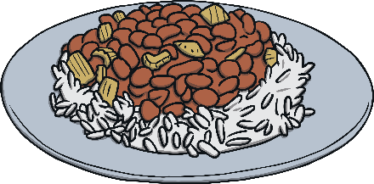
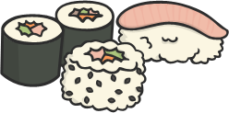
What Type of Food is Eaten?
In Japan, popular foods include:
Rice
Fish
Vegetables
Soy products. These are products such as soy beans or meat alternatives.
They use these foods in many different meals including soup.
Sushi and sashimi are also very popular. Sashimi includes a raw ingredient. Do you know what it is?

Slide 6
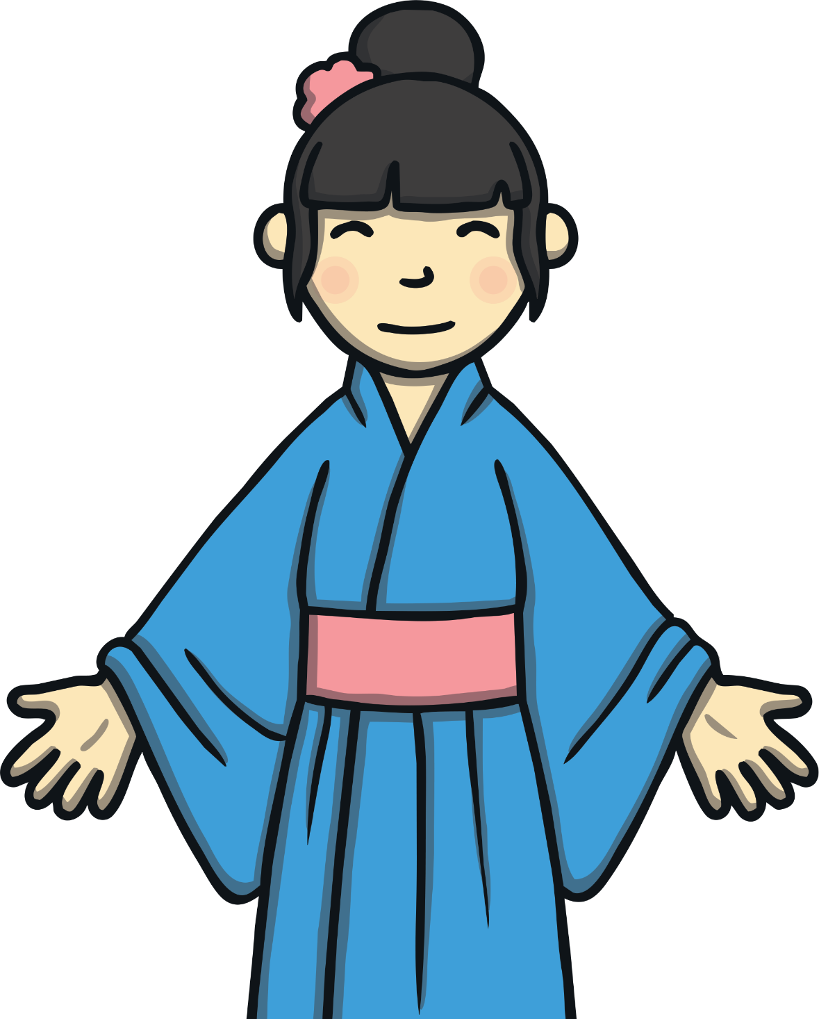
raw fish

Slide 7
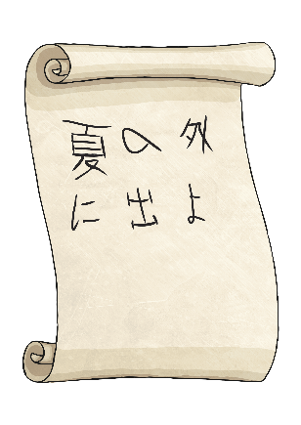
Japanese Writing
Japanese writing combines two things.
Logographic kanji (how it is written down) | Syllabic kana (sounds)
The Japanese writing system is thought to be one of the most complicated in the world. When it is written down, there are two different ways.
tategaki It comes from the traditional Chinese system. The characters are written in columns going from top to bottom. They also go from right to left. | yokogaki Modern Japanese writing. It reads from left to right.
Which is English writing like?

Slide 8
Japanese Writing
Interesting Facts
A book written in tategaki opens with the spine of the book to the right.
A book written in yokogaki opens with spine of the book to the left.
Who can come and demonstrate this at the front?

Slide 9
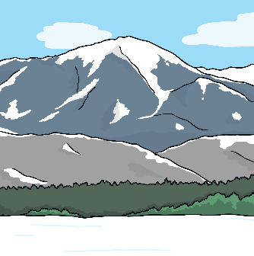
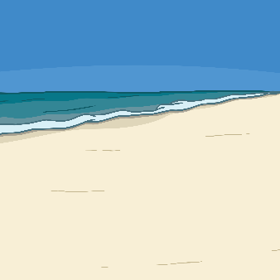
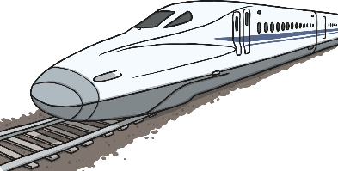
Places to Visit in Japan
Mount Fuji Mount Fuji is the highest mountain in Japan.
It is a dormant volcano. This means it is not active.
It last erupted in 1707.
Ring of Fire
Japan lies on the ‘Ring of Fire’ in the Pacific Ocean. This is
where there is a group of volcanoes that have very large eruptions. In Japan there are more than 108 active volcanoes.
Shinkansen Train
This is the high speed train in Japan. It can go as fast as 200 miles per hour. This is almost three times as fast as we can go on the motorway. It is the world’s fastest passenger train.

Slide 10
Interesting Facts
Japan has hosted the Olympic Games three times. It will also host it again in 2020.
2. Sumo wrestling is the national sport of Japan. Sumo wrestlers are often very large and wear their hair on the top of their head in a bun.
3. Japan is where many electronic things have been invented. Cameras, computers and cars are often produced here.
4. In Japan, people have the third longest life expectancy in the world. Men live to 81 years old and women to almost 88 years old.
Which fact do you find most interesting?

