Slide 1
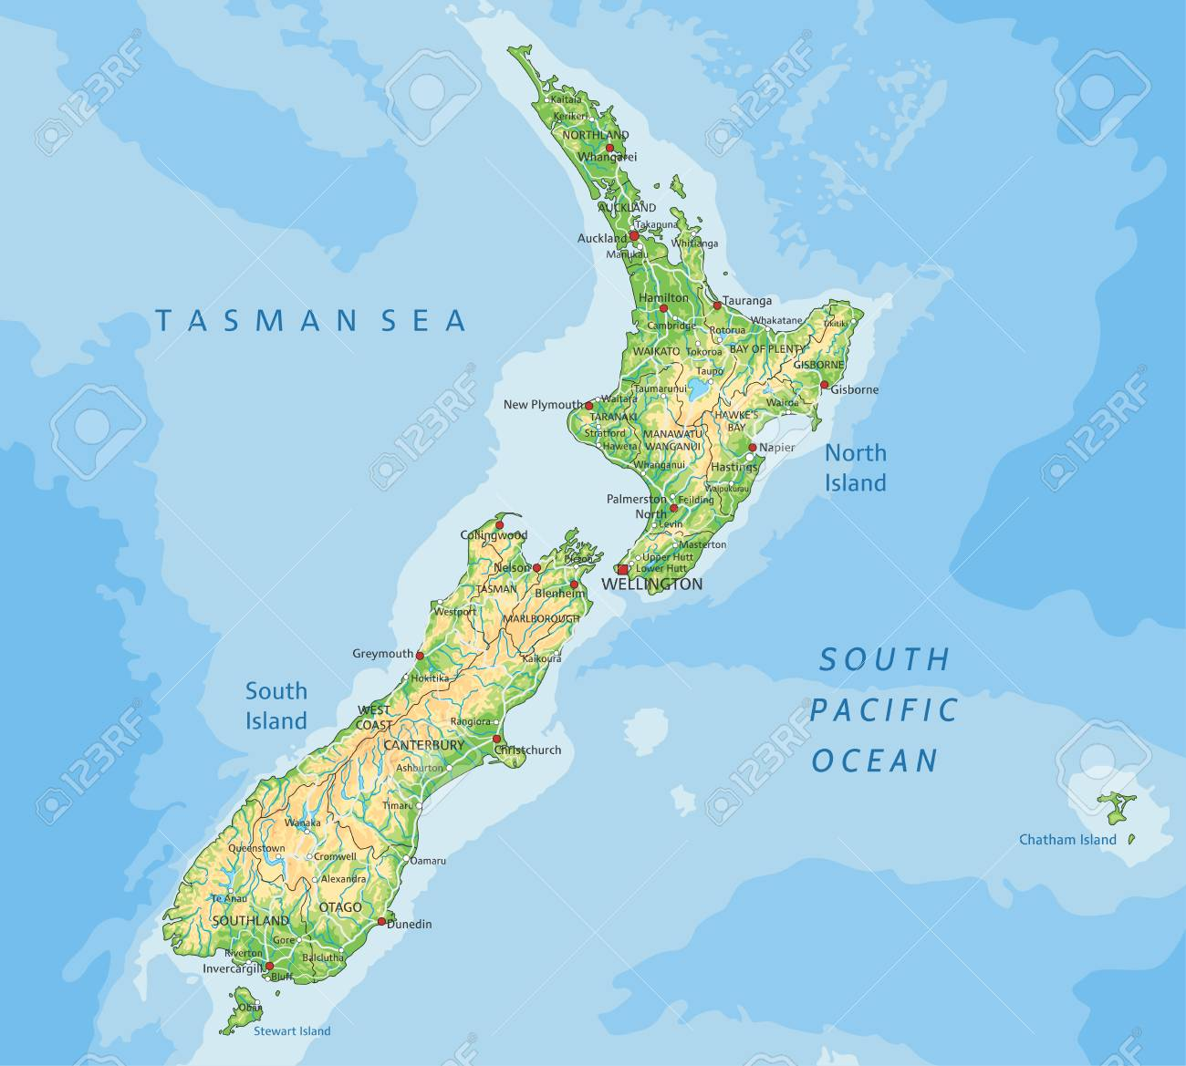
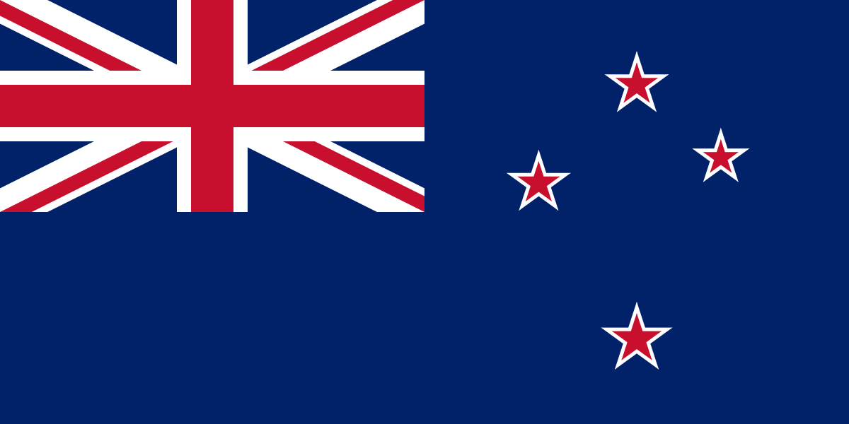
New Zealand
Aotearoa-Land of the long white cloud
By Kaitlin, Nathan & Addison Lawlor

Slide 2
Introduction
New Zealand is an island nation located in the southwestern Pacific ocean. The country is split up into two main islands – the North Island and the South Island. When compared with other countries New Zealand ranks highly in areas such as quality of life, health and education.
Population: 4.886 million
Capital : Wellington
Area : 268,021 sq. km
Currency : New Zealand Dollar
Official Languages : English, Maori
Prime Minister : Jacinda Ardern
* To watch the videos in this project please enable media from online sources

Slide 3
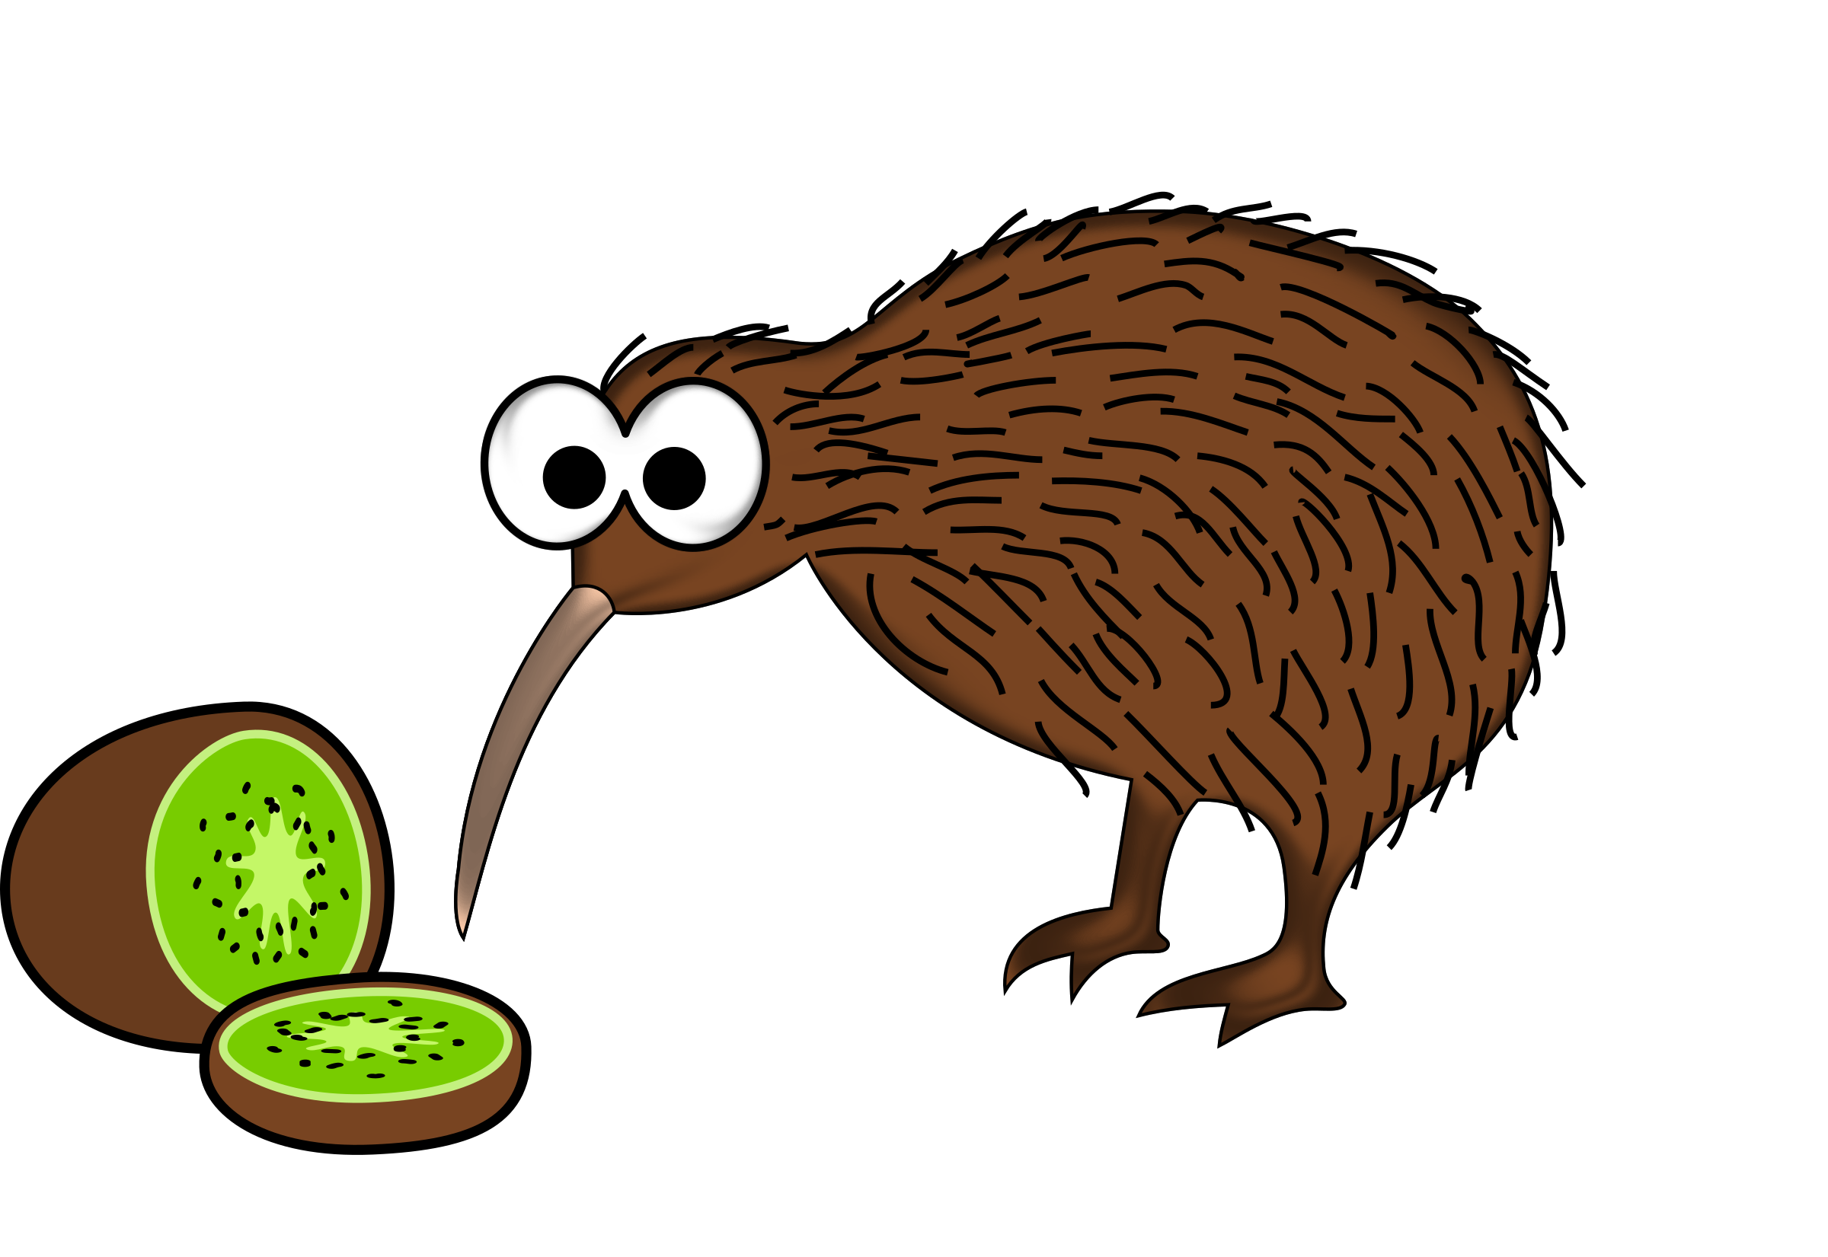
Fun Fact
Did you know New Zealanders are known as Kiwis after their national bird (not the fruit!!!!)

Slide 4
Culture
Maori culture – The Maori people are believed to have been the first people to settle on the islands of New Zealand. They travelled to New Zealand in waka (canoes) from smaller Pacific islands in the early 1300’s.
Over several centuries of isolation they developed their own unique culture including language, mythology, crafts and preforming arts.
Some examples of Maori culture include the Hongi which is a traditional greeting done by pressing the nose and forehead against someone else's. The Haka is a Maori war dance that was traditionally saved for the battlefield but is probably better known now as being performed by the New Zealand rugby team. But more about that later!!
The Maori were considered to be great warriors. This became very important when European settlers arrived in the 17th century. It allowed the Maori chiefs to negotiate the Treaty of Waitangi with Britain.
New Zealanders are proud of both their Maori and European heritage. Like Ireland many signs are in both English and Maori. Even the national anthem has a verse in each language!

Slide 5
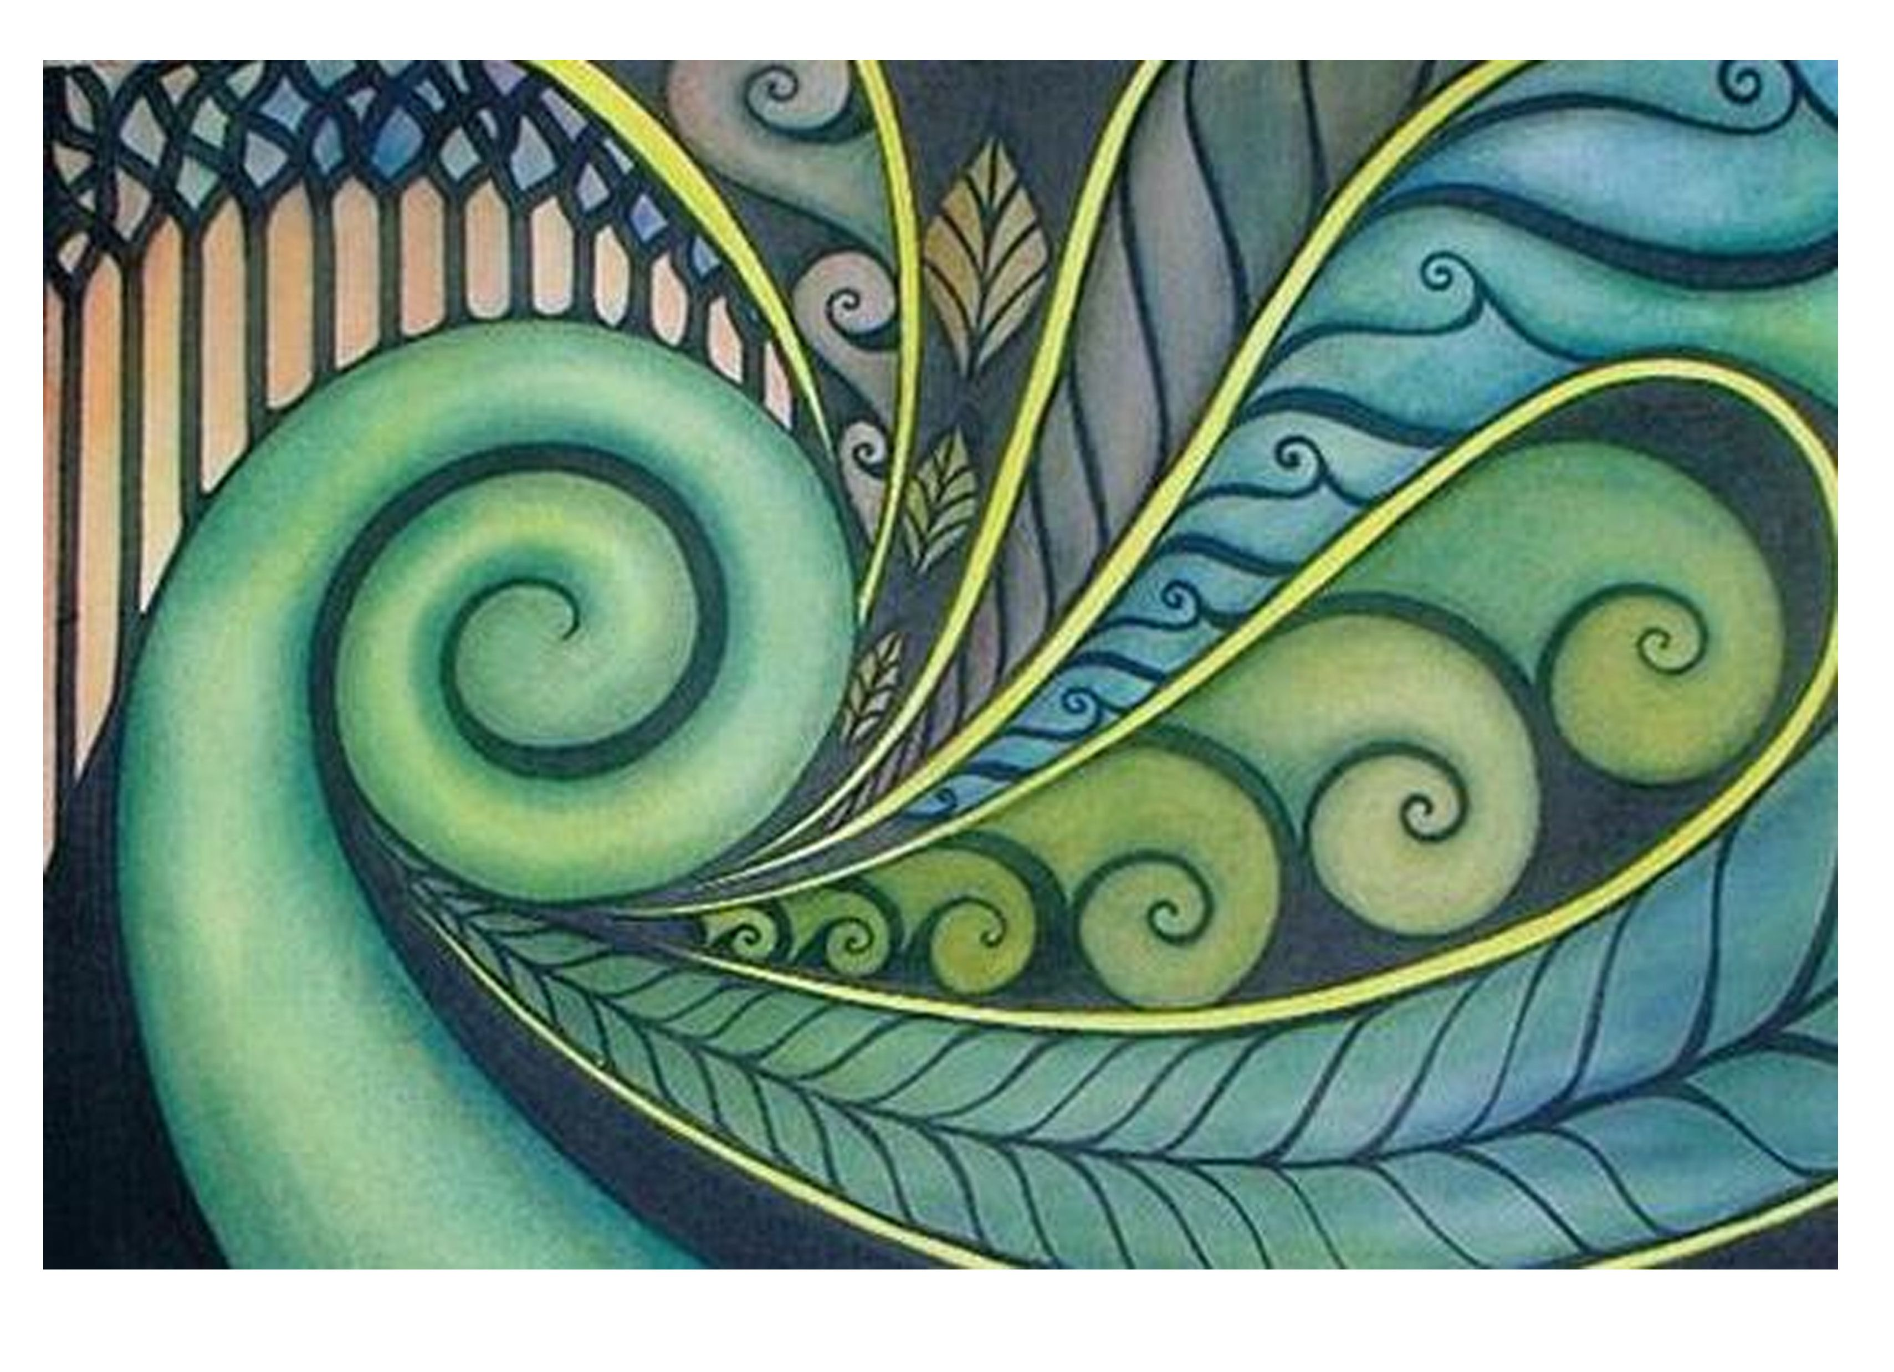
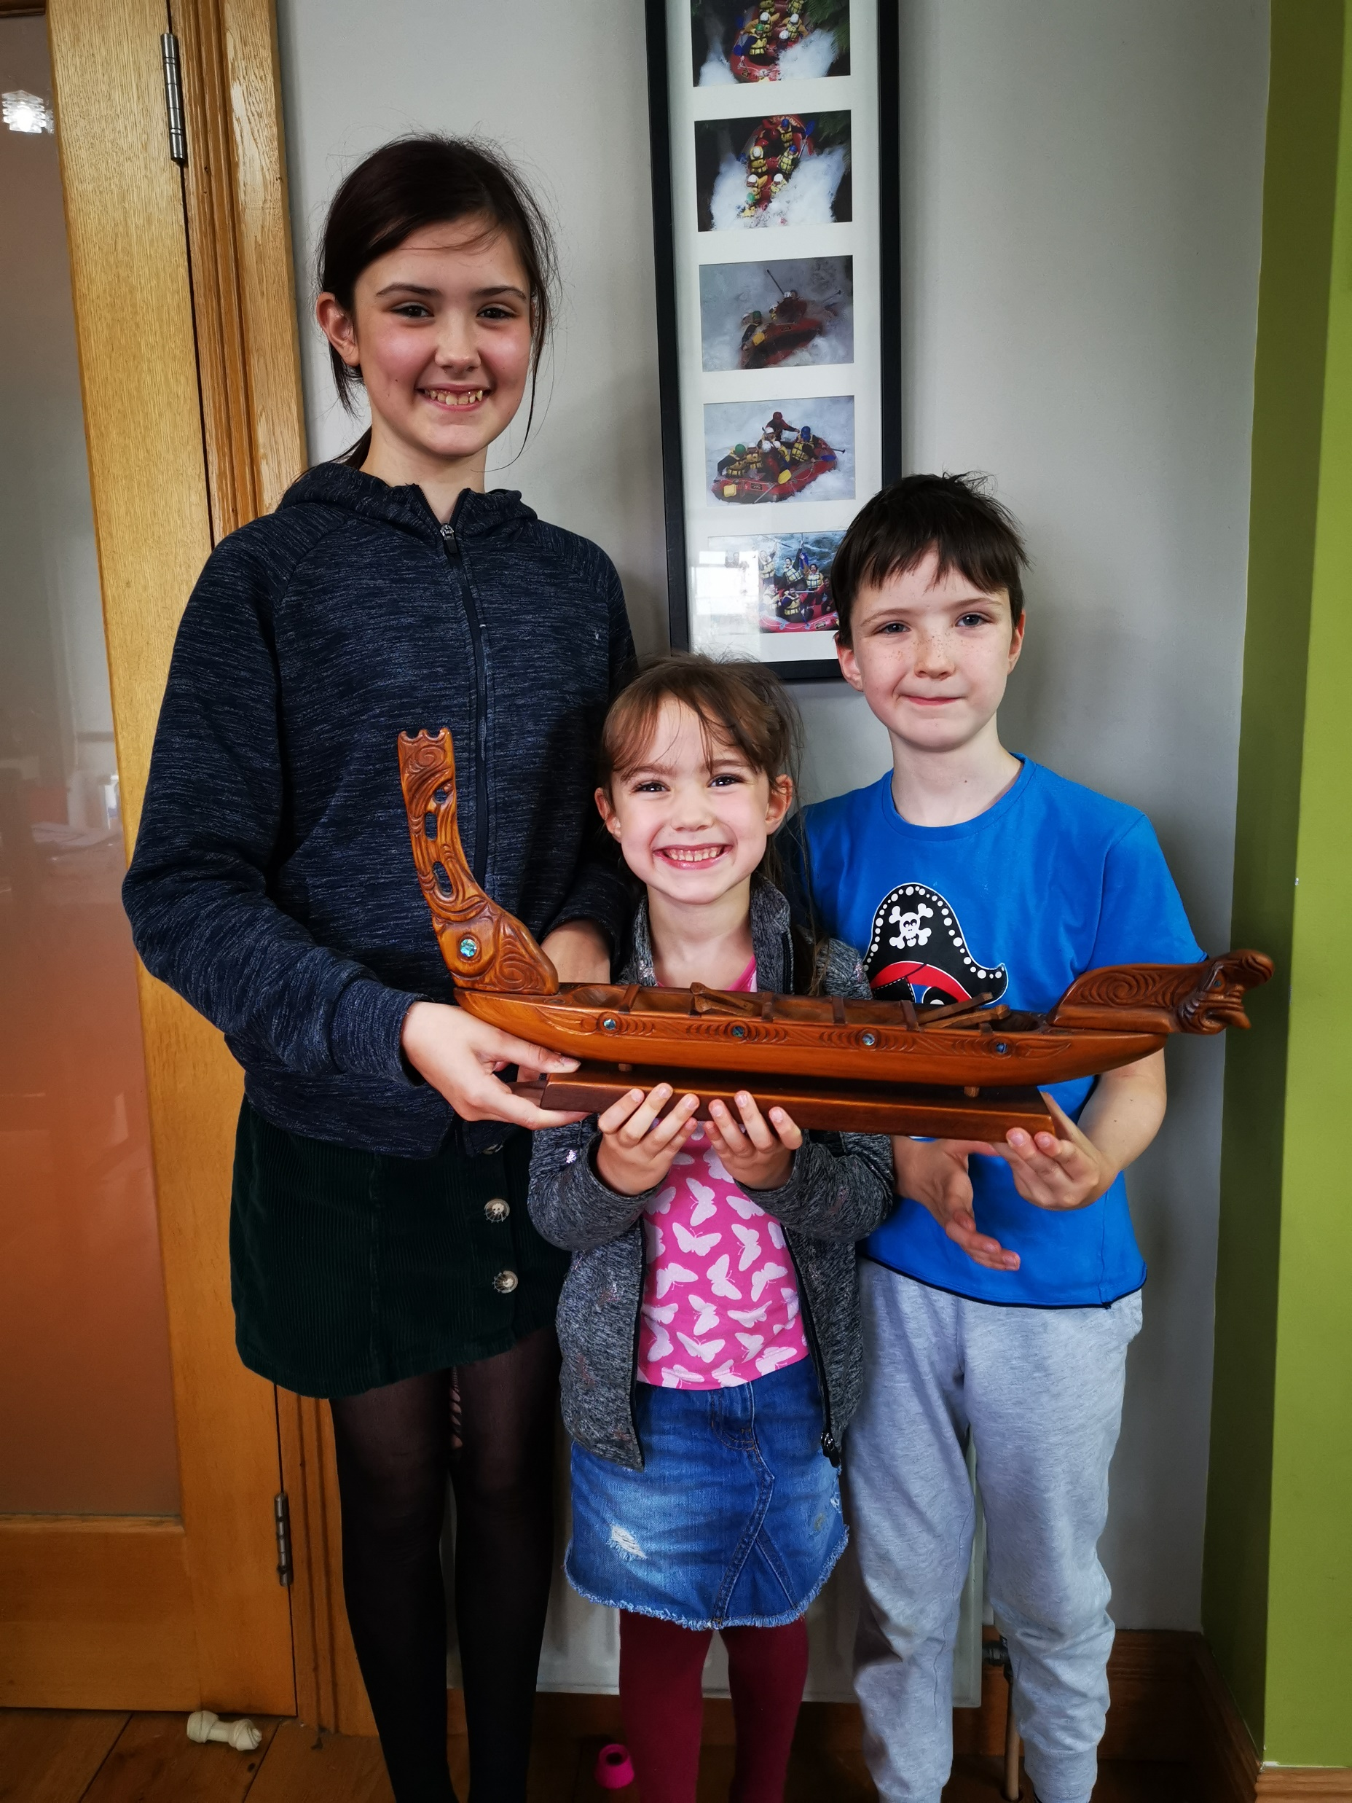
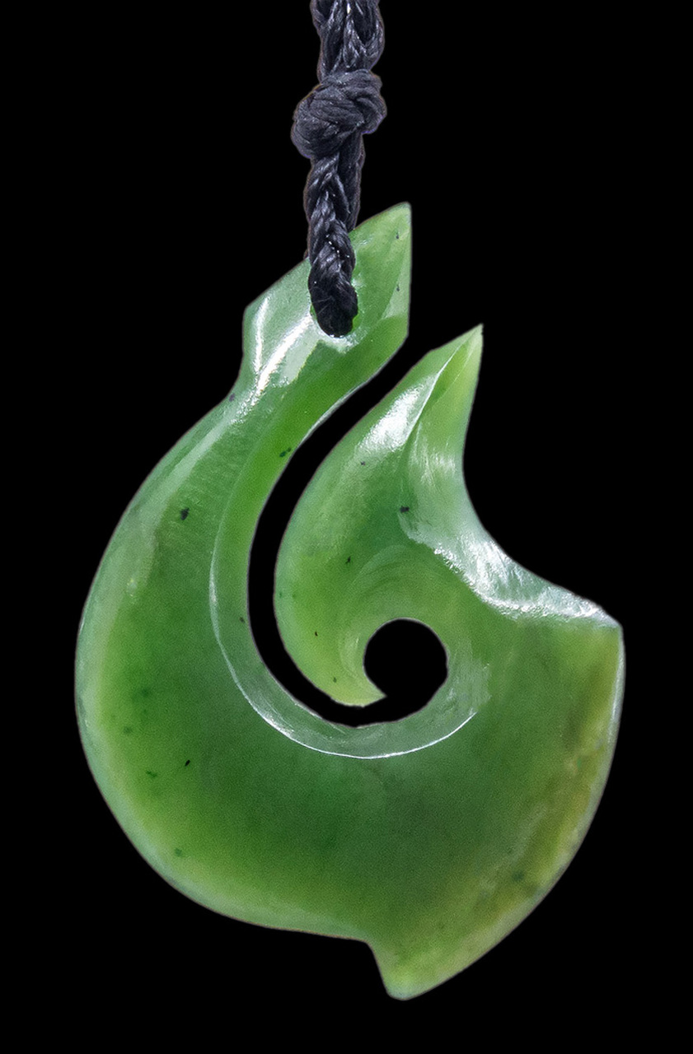
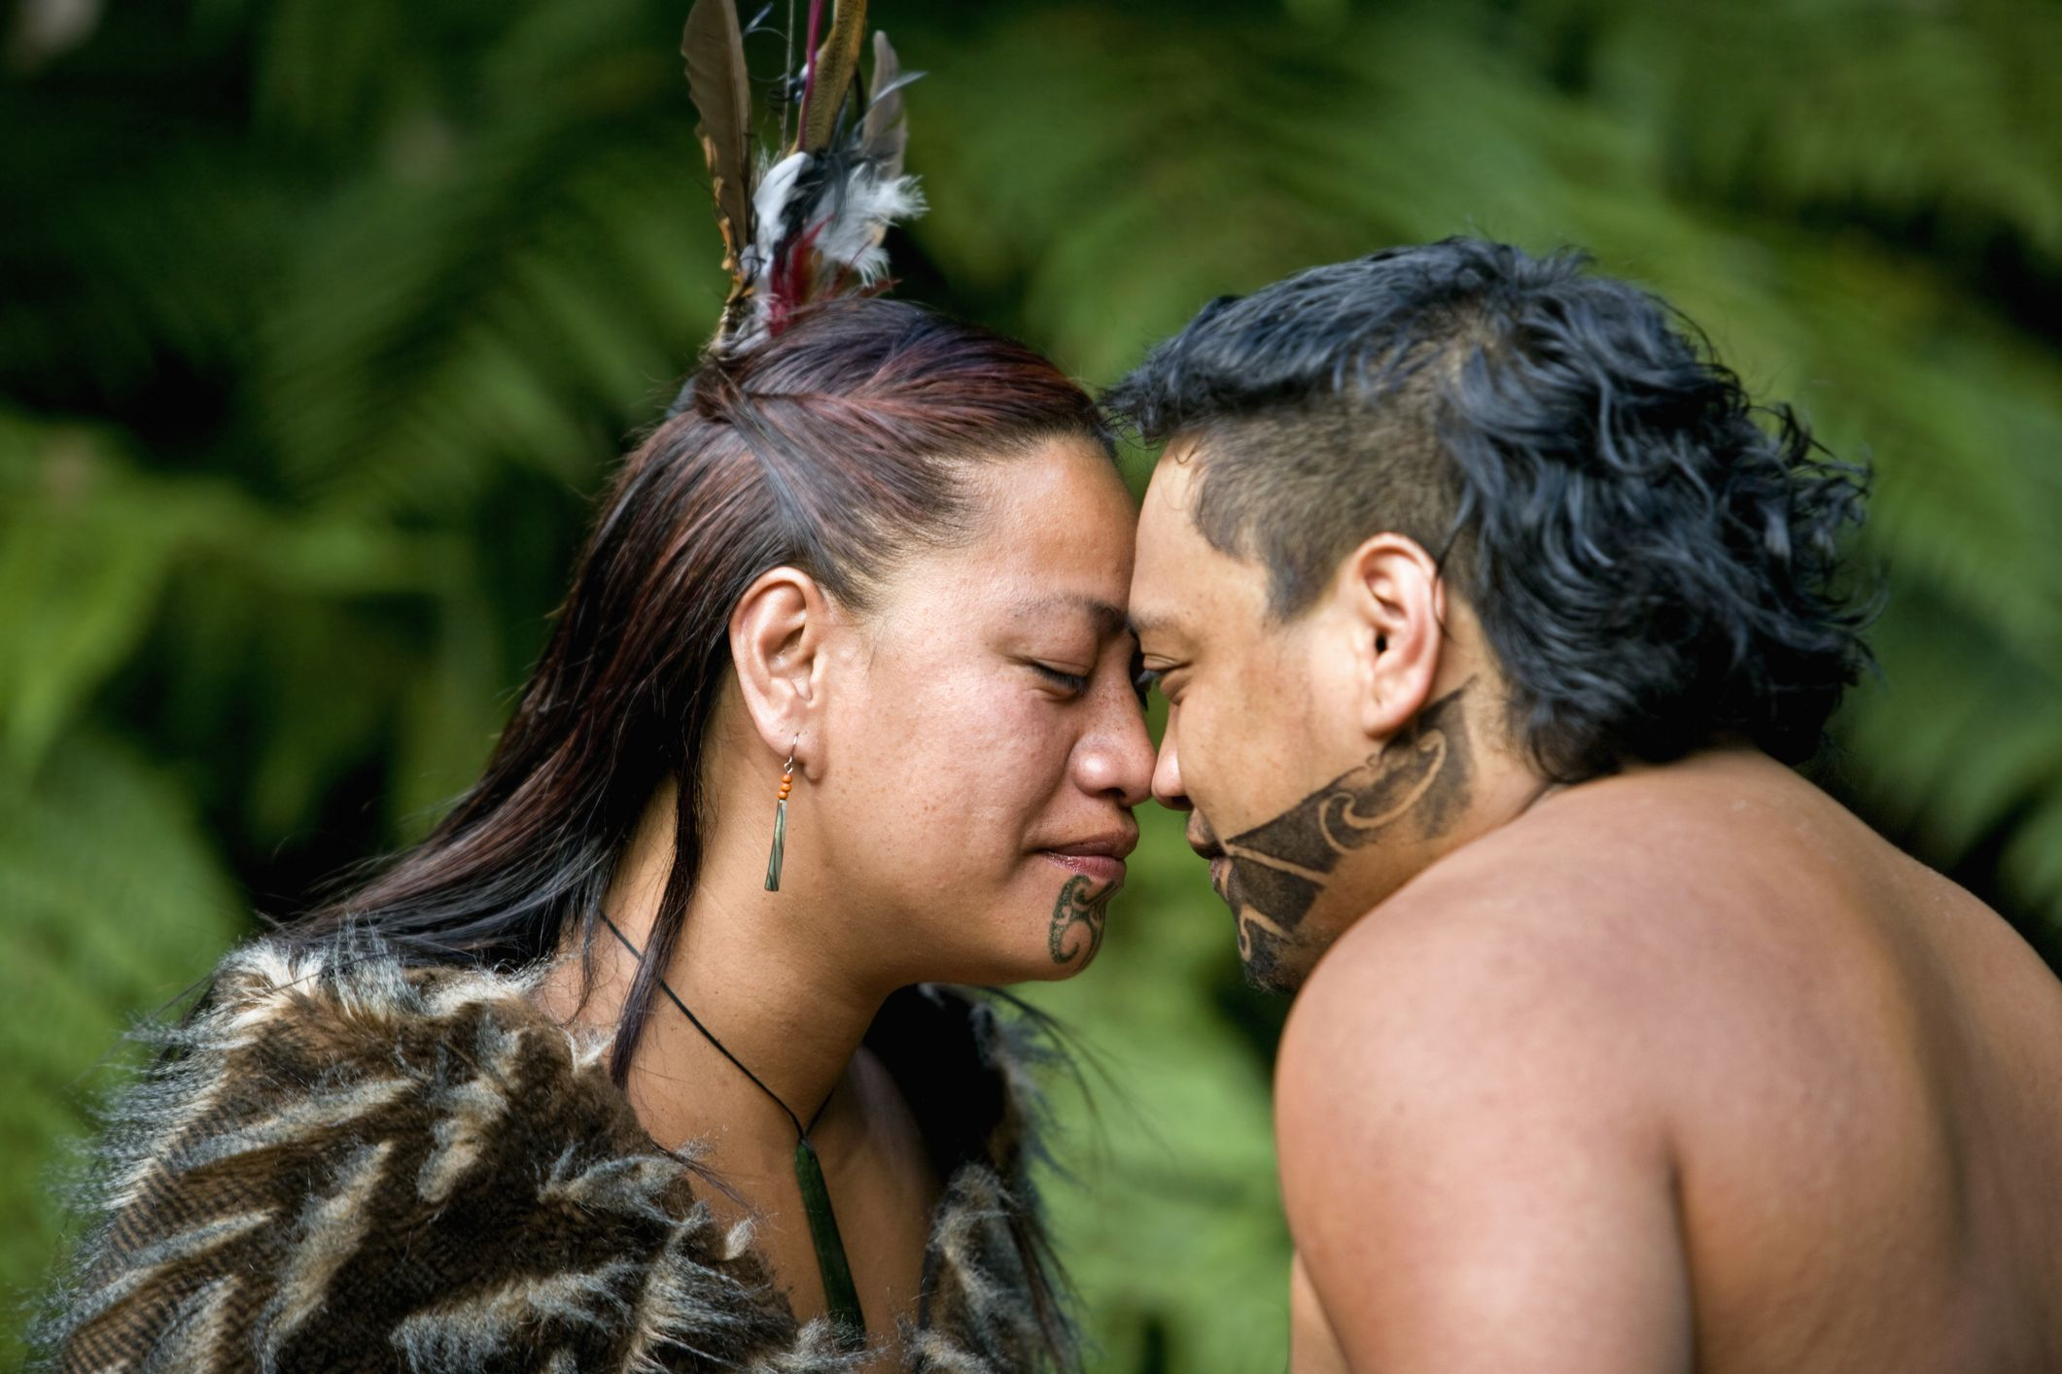
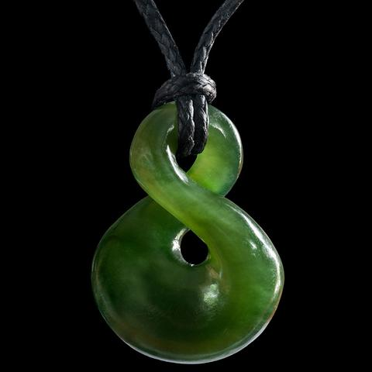
Traditional Maori Artwork
We have our own traditional Maori waka at home. It was brought back by our parents from their honeymoon
Hongi- Traditional Maori Greeting
Carved Greenstone Necklace

Slide 6
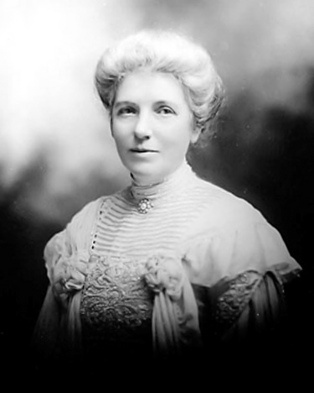
Fun Fact
Did you know that in 1893 New Zealand became the first country in the world to allow women to Vote.
Go New Zealand!
Kate Sheppard led the fight for women’s right to vote in New Zealand

Slide 7
Sport
New Zealand play lots of sports such as cricket, basketball, netball and football but there's one sport that rises above them all. Rugby! New Zealanders, also known as Kiwis are Rugby mad! The national team are known as the All Blacks because of their black kit and they are good, very good. The men’s team have won the Rugby World Cup three times! And the women’s team have won it an incredible five times!! The women’s rugby team are known as the Black Ferns.
The All Blacks perform the Haka

Slide 8
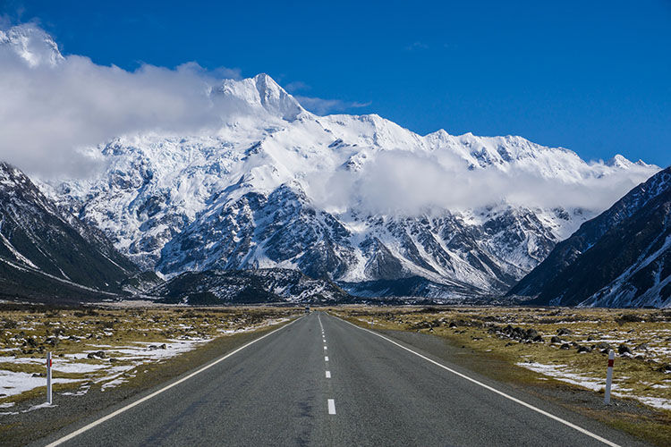
Geography & Climate
There are 2 main islands and around 600 smaller islands. The islands were created just 23 million years ago when land was thrust out of the ocean by volcanic forces. New Zealand has more than 50 volcanoes, some of which are still active today. Sharp snowy peaks, rocky shores, and pastures create a majestic landscape.
The South Island is home to the highest mountain peak in New Zealand, Aoraki (Formally Mount Cook), which rises to 12,316 feet (3,754 meters) and is called "Cloud Piercer" by the Maori people.
New Zealand has a temperate climate similar to Ireland.

Slide 9
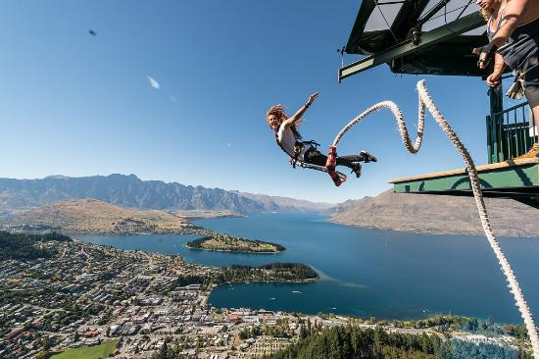
Fun Fact
Bungee jumping was invented in New Zealand

Slide 10
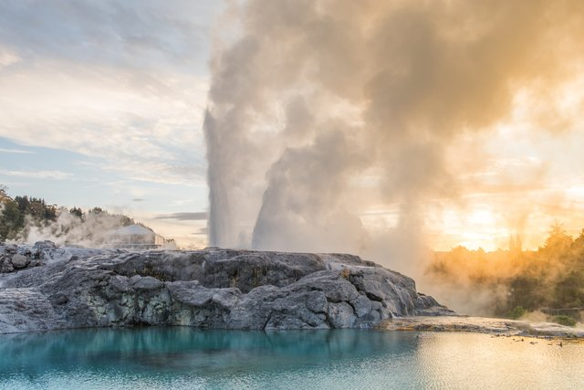
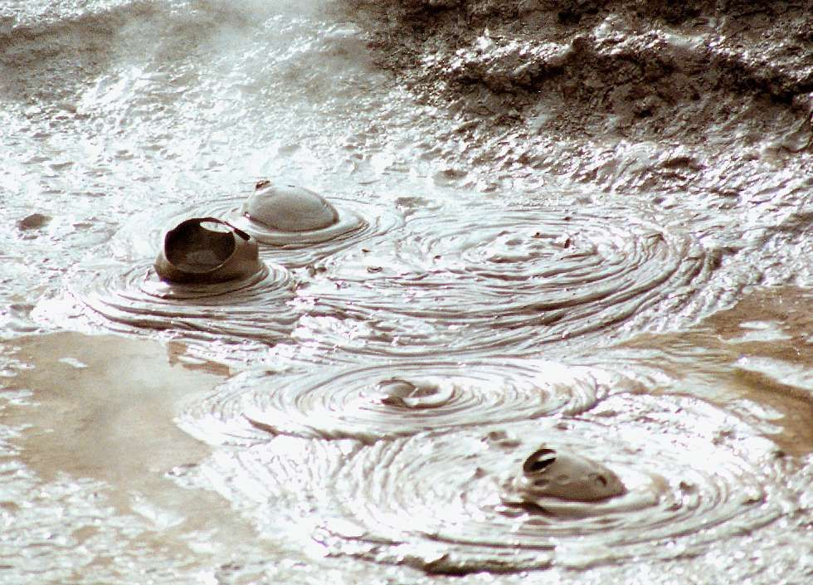
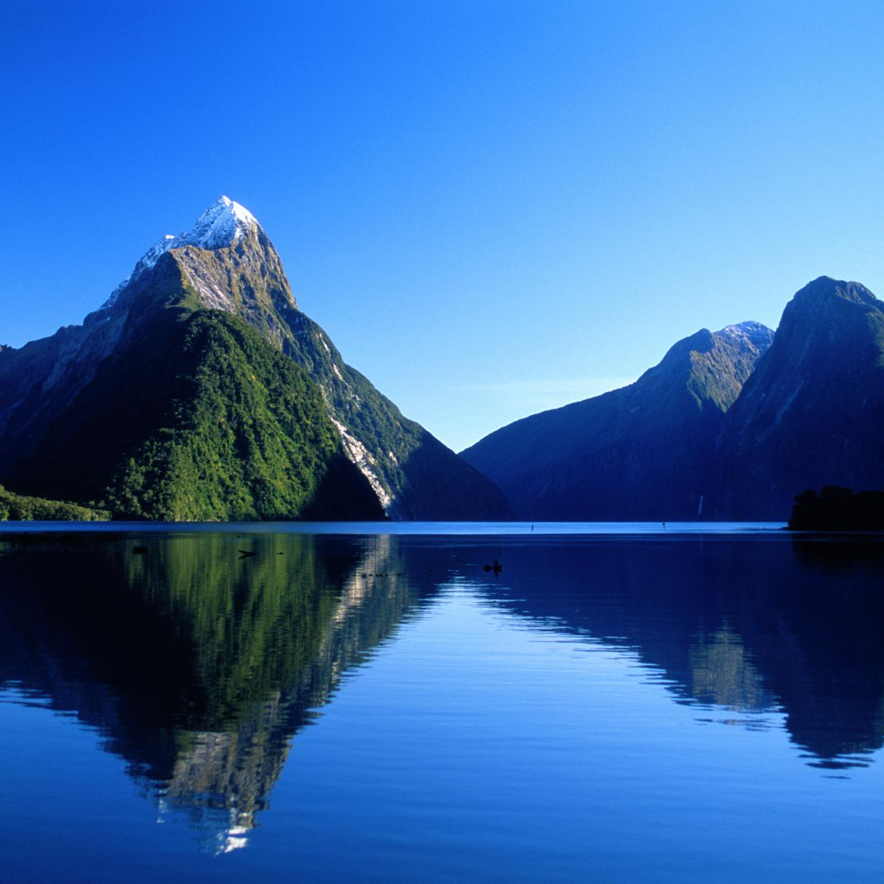
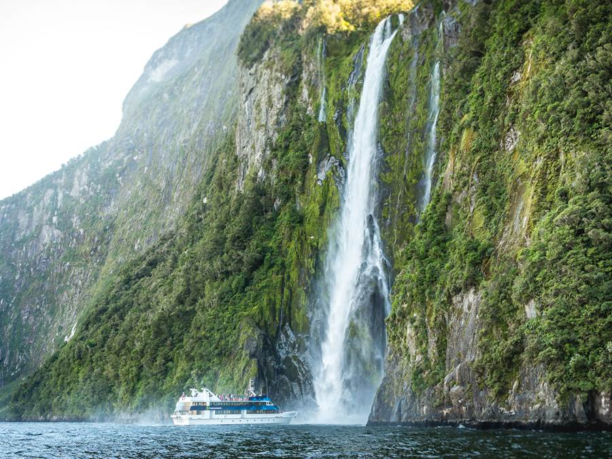
Places of interest
Rotorua- one of New Zealand’s main tourist attractions known for its volcanic (geothermal) activity such as geysers and hot mud pools. The place smells like rotten eggs due to the sulphur!
Milford Sound- Milford Sound is a fiord in the southwest of New Zealand’s South Island. It’s known it’s towering Mitre Peak, plus rainforests and waterfalls like Stirling and Bowen falls
Geyser & hot mudpool at Rotorua
Mitre Peak & Spectacular waterfall

Slide 11
Flora & Fauna
Apart from two bat species there are no native land mammals in NZ
Many species are long-lived: kiwi can live for 30 years, and kauri trees for 1,700.
Many birds and insects are flightless – they did not need to fly as there were few predators.
There are thought to be over 6000 species of beetle
NZ also have 3 different types of native penguin
Much of the South Island is covered in rainforest

Slide 12
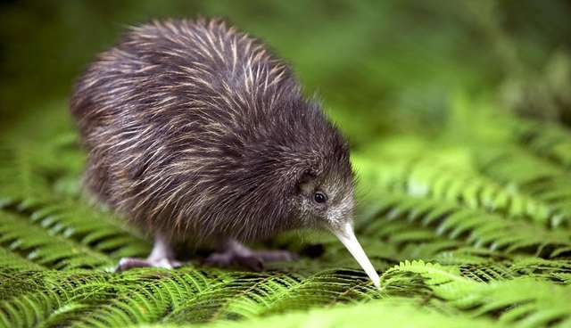
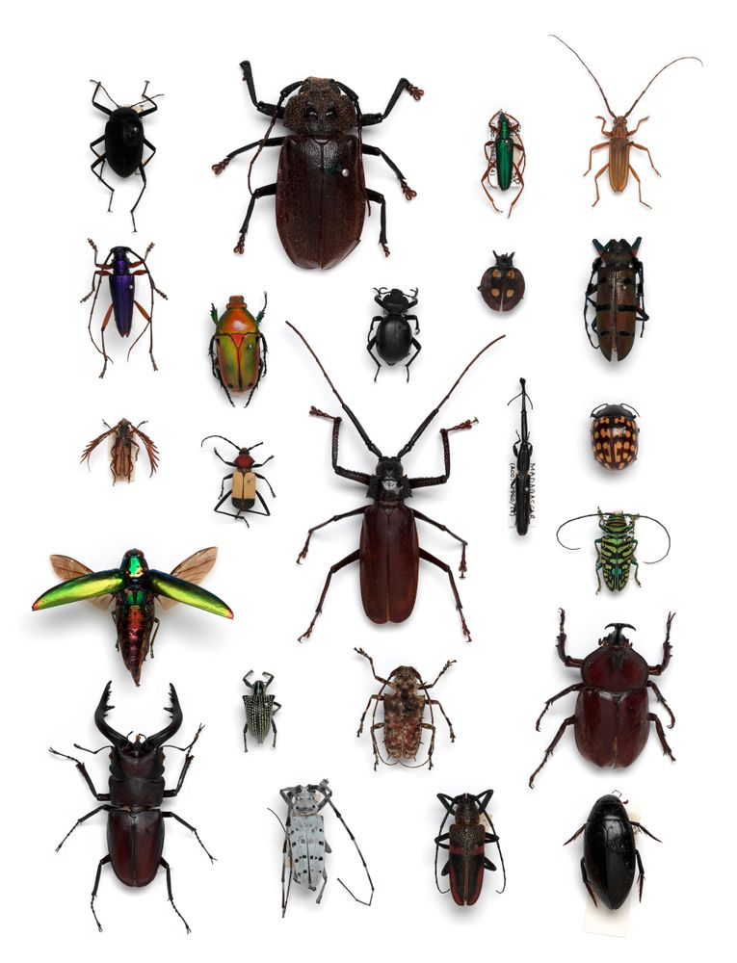
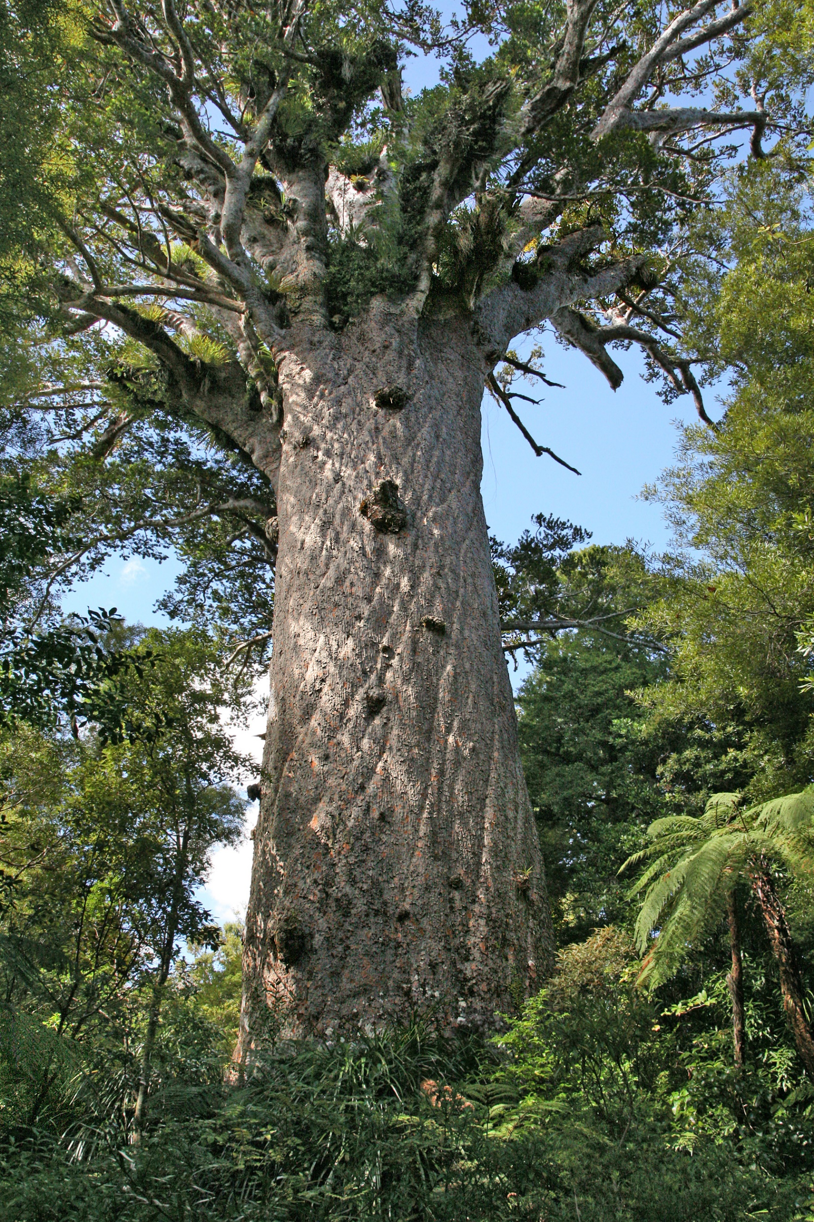
Kiwi
The enormous Kauri tree
Some of the over 6000 types of beetle
Silver fern

Slide 13
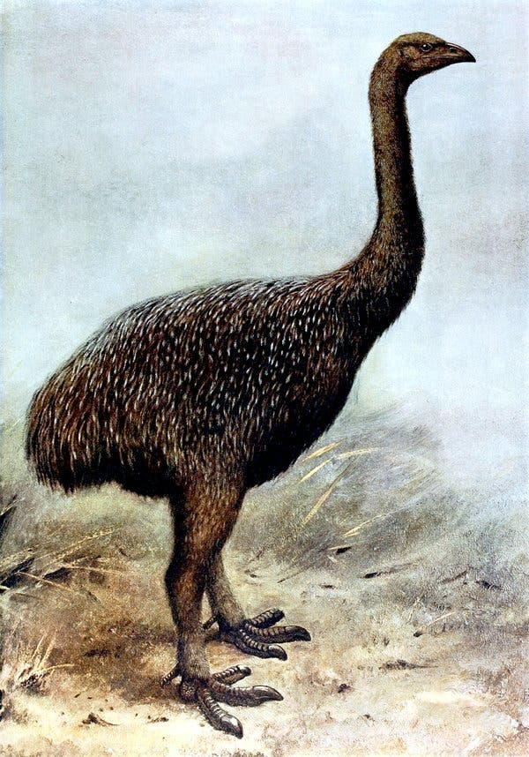
Fun fact
The Moa was an enormous flightless bird found only in New Zealand. It could reach over 3.5 metres in height. It was hunted to extinction by early Maori settlers

Slide 14
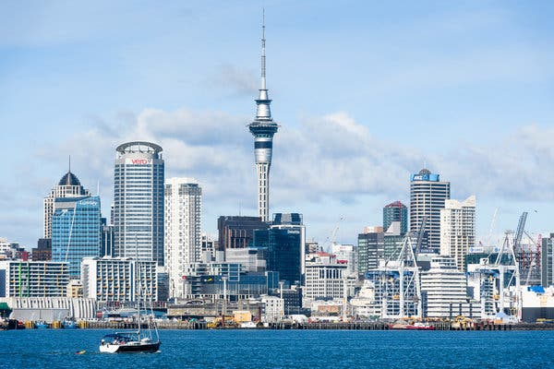
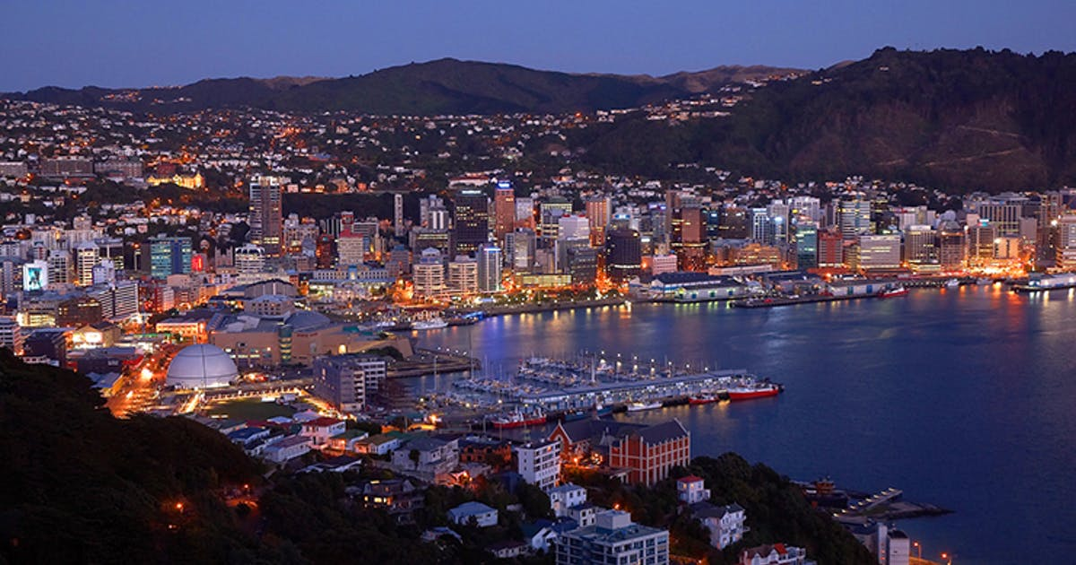
Cities
The 5 major cities in New Zealand include
Auckland pop 1,606,564
Wellington (Capital) pop 414,818
Christchurch pop 398,520
Hamilton pop 152,641
Tauranga pop 110,338
NZ’s largest city Auckland
The capital city Wellington

Slide 15
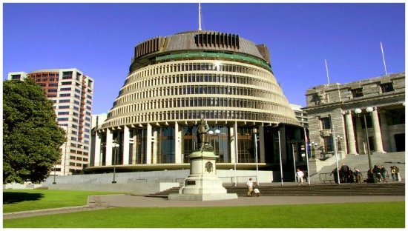
Fun Facts
New Zealand’s parliament building which is located in Wellington is known as The Beehive because of its unique shape

Slide 16
Adventure
If you are looking to find adventure then NZ is the place to go. You can take part in many different types of heart stopping activities here. Queenstown on the South Island is the adventure capital of NZ
Bungee jumping
White water rafting
Fly by wire
Zorbing
Skiing
Luge
Fly by Wire – Our Parents actually did this!!!

Slide 17
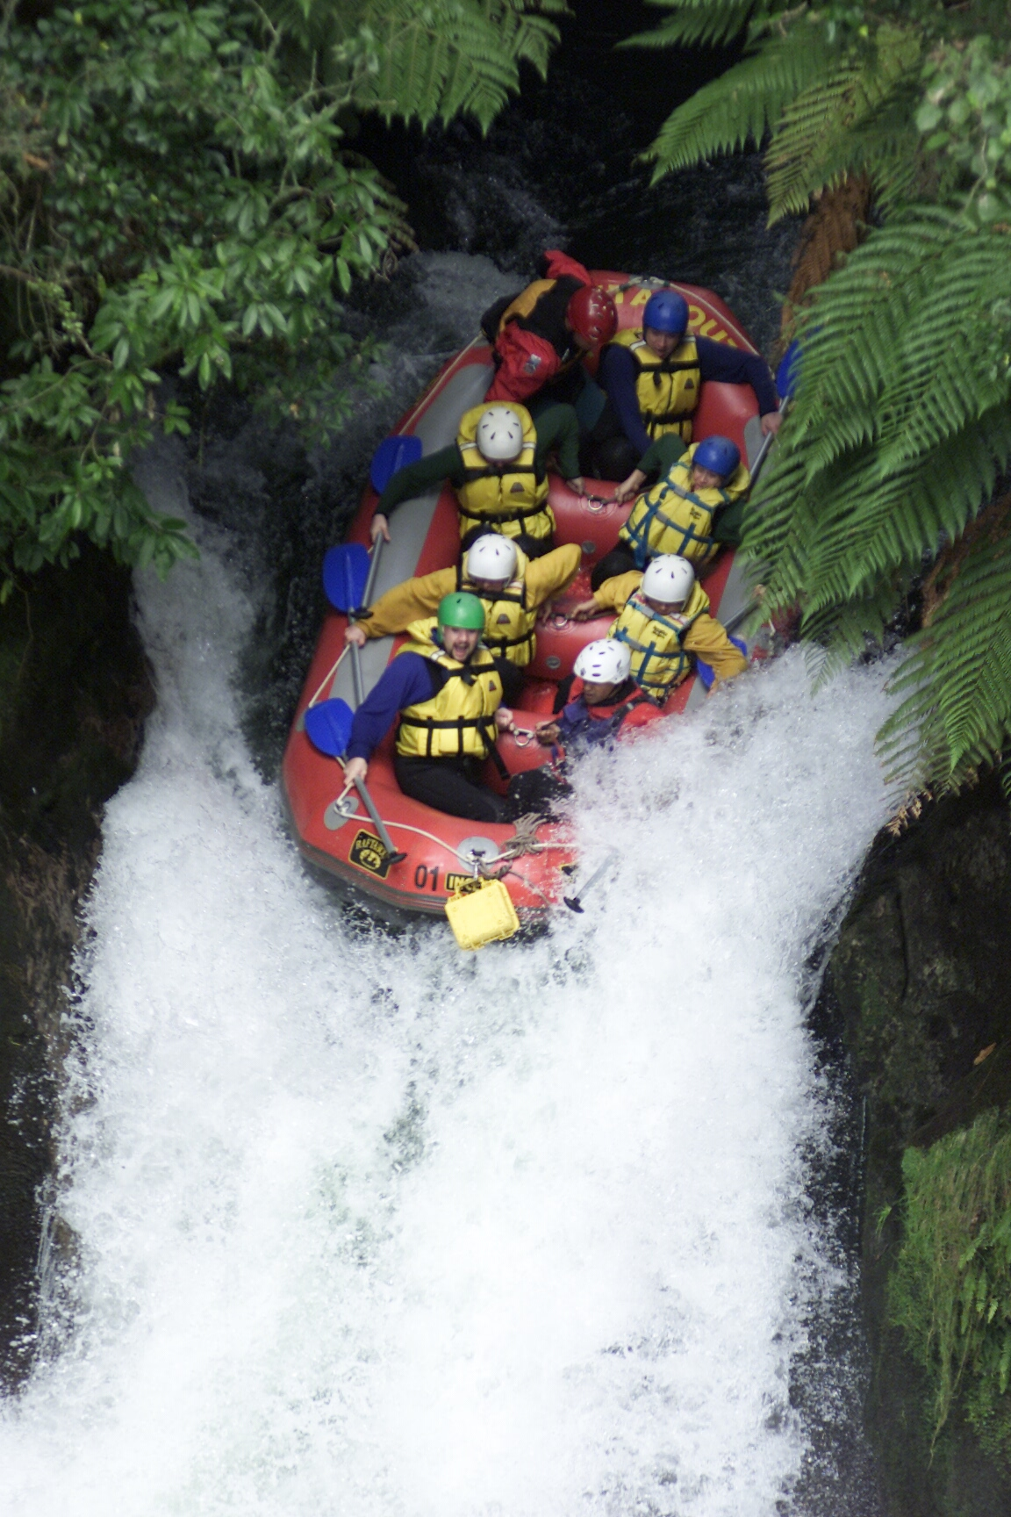
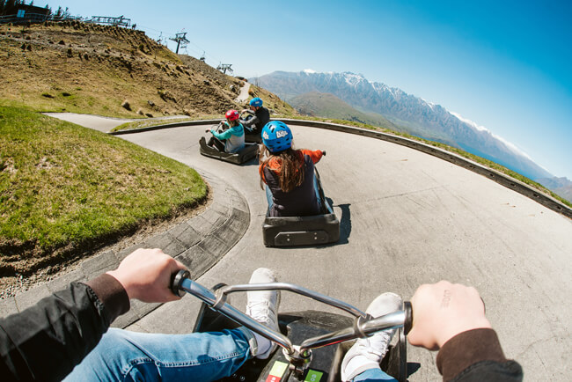
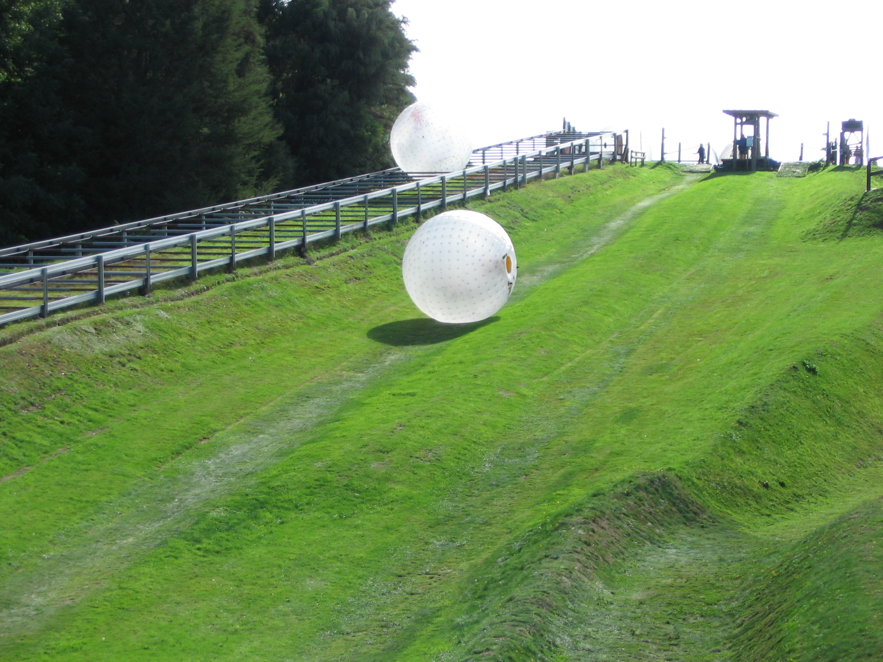
Luge
And This (Actual picture of them in the boat)
Zorbing

Slide 18
Conclusion
Our family has a huge connection with New Zealand. Our parents lived there for a year and returned years later for their honeymoon. We also have family who live there in a place called Whanganui. We would love to go and visit them
We hope you have enjoyed this presentation as much as we loved making it
Thank you and as they say in New Zealand, Kia ora

