Slide 1

Welcome to our Virtual School Tour.
First Class,
Ms Haughney
Can you guess where we are going?

Slide 2


Click here to hear a message from Ms Haughney.
Here are some clues...
It is a very hot place with lots of sunshine.
It is far away.
There are lots of different things to see and hear .
You will be going on a plane.
You will need a passport.

Slide 3
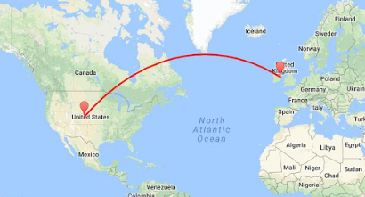
We are going to the USA.
We will visit San Diego Zoo.
We will fly to the USA.
We are in Leixlip,
Co. Kildare, Ireland
Click the music note and sing along!

Slide 4
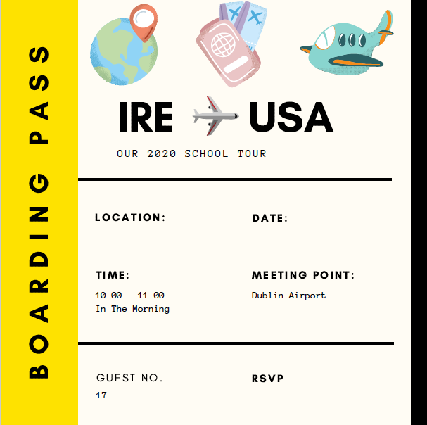

Time to board the plane and take off!
Have your boarding card ready to scan.
Departure gate
June 2020

Slide 5
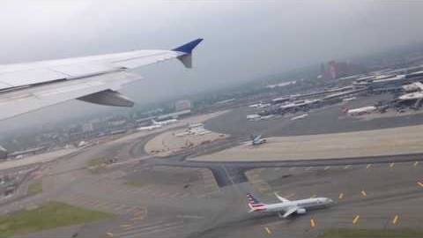
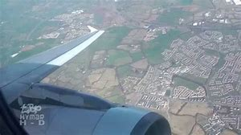
Time to take off!
Click on me to hear a message!
Window view of Ireland.

Slide 6
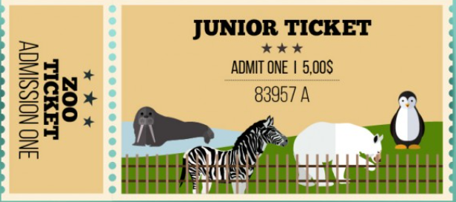
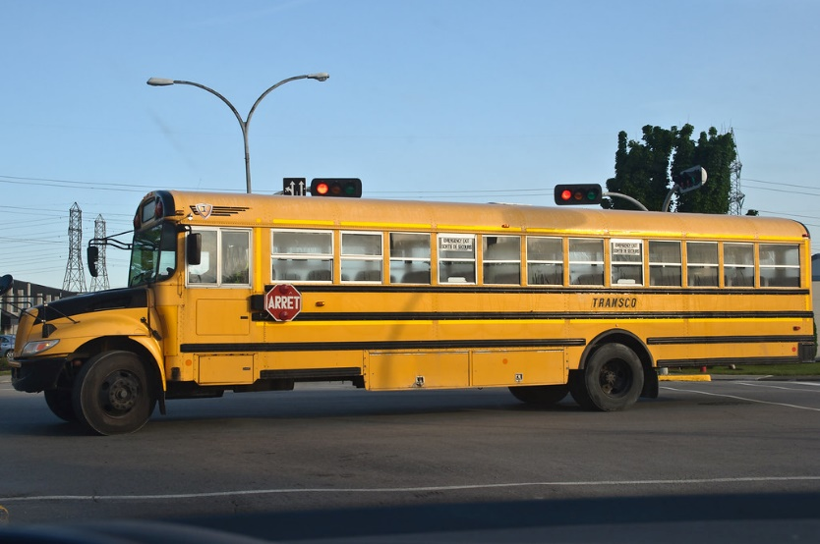

Click on me!
Off to San Diego Zoo we go!
Time for a song as we drive there!
Click below for our bus song.

Slide 7

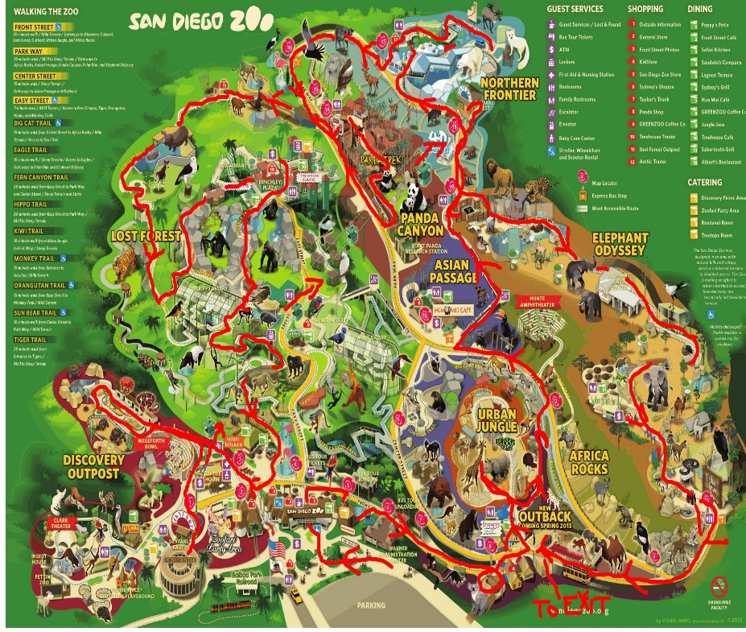
We made it!
Click on me!
I wonder what animals we will see..

Slide 8
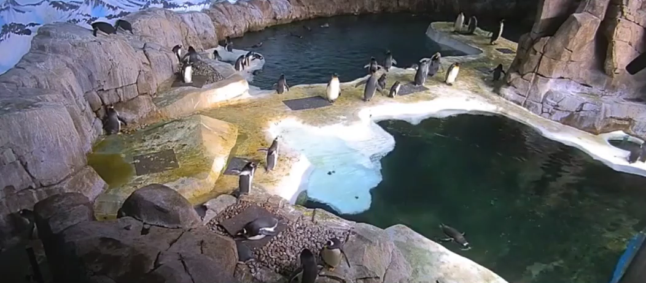
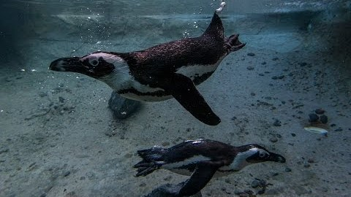
First stop, Penguin Beach.
Click below for the live camera on Penguin Beach in the zoo.
One of the penguins at the San Diego Zoo is called Jack!

Slide 9
Facts about Penguins
Penguins are flightless birds.
While other birds have wings for flying, penguins have adapted flippers to help them swim in the water.
Most penguins live in the Southern Hemisphere.
Penguins eat a range of fish and other sea life that they catch underwater.
Penguins can drink sea water.
Penguins spend around half their time in water and the other half on land.

Slide 10
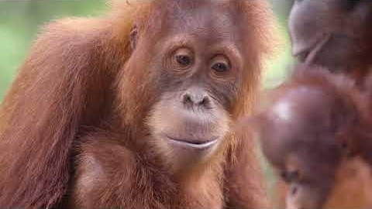
Animal Friends
Click on me!

Slide 11
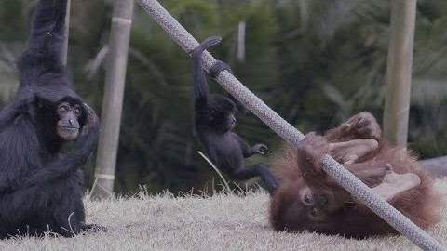

Lets see what life is like in the trees.
Time to meet the Orangutans.
Click on me!
Click below to hear an Orangutan's call.

Slide 12
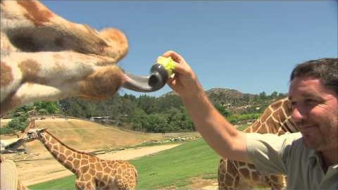
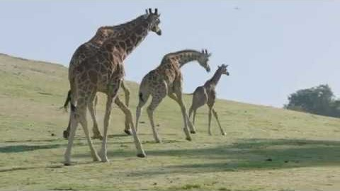
Next stop, the Giraffes!
Click on me!

Slide 13
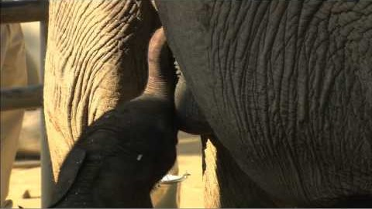
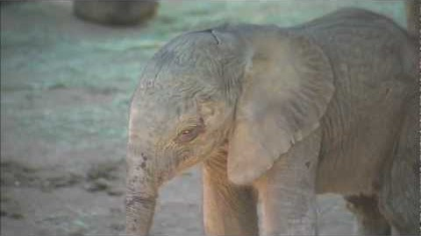
Up next, my favourite animal, the elephant.
Click below to see the elephants in San Diego Zoo!
Watch a baby elephant learn to take its first steps.
A baby elephant is called a calf.
Click here to hear an elephant trumpeting.

Slide 14
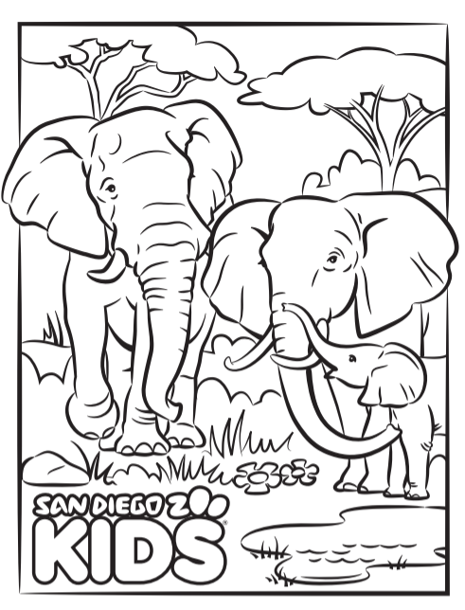
Colour the picture.

Slide 15

Lunch Time!
If the weather is nice, go outside and have your picnic outside.
Enjoy your lunch !

Slide 16
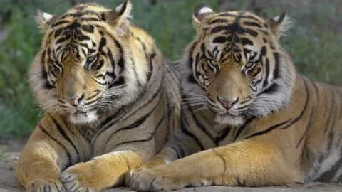
Click on me!
The Big Cats
Click here to meet the two lion cubs at San Diego Zoo.
https://kids.sandiegozoo.org/videos/lion-cubs
Click below to hear a tiger roar.

Slide 17
Fun Facts about tigers
Tigers are the largest wild cats in the world.
Tigers are carnivores, eating only meat.
Tigers are solitary hunters, and generally search for food alone at night.
Tigers are good swimmers!

Slide 18
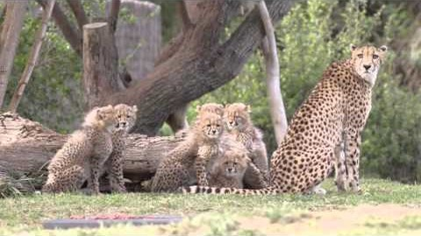
A need for Speed!
The African Cheetah
Watch this video to 1 minute 20 seconds.
Click here to hear the bark of the Cheetah.

Slide 19
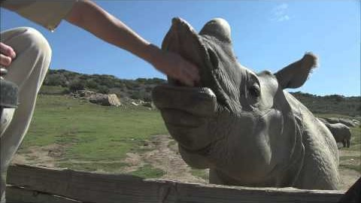
A Crash of Rhinos!

Slide 20
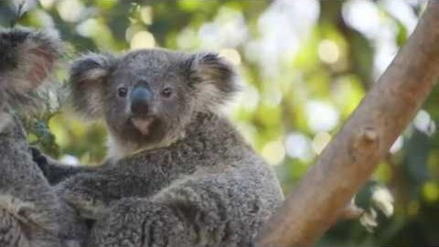
Koala
‘I am not a bear!’
Click on me!
Click here to find out what a male koala sounds like.

Slide 21



Time to say goodbye to the animals, as we have to catch our plane back to Ireland.
Some activities for the plane journey home:
Design your own zoo map
Design your own zoo enclosure for animals
Draw yourself as a zoo keeper
I hope you had a lovely day at the zoo.
Ms Haughney☺

