Slide 1

Science
What makes us unique?

Slide 2
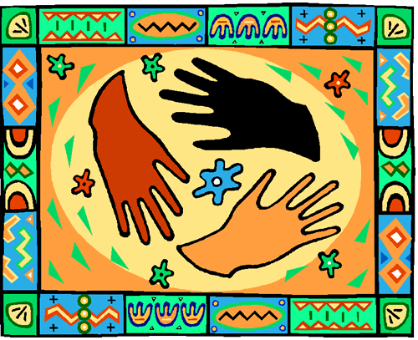
Individual difference
Finger prints
Dominant eye
Blind spot

Slide 3

Fingerprints
Did you know that your finger prints are totally unique?!
How do you think this helps in the world today?
Today we are going to explore and study our finger prints!

Slide 4
Fingerprints
With your pencil scribble on a piece of white paper.
Then rub the top of one finger over this until it is black.
Press your finger firmly onto the sticky side of some sellotape.
Now stick the sellotape onto the white paper, your fingerprint should have transferred to the paper.

Slide 5
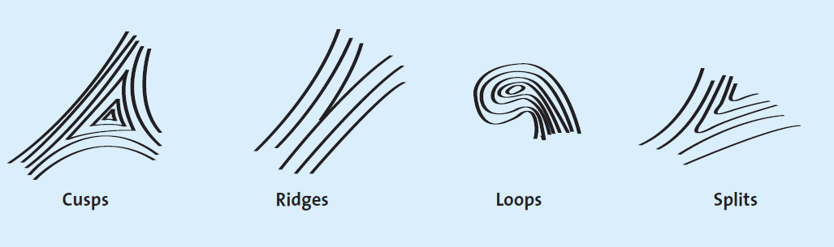
Fingerprints
Can you find any Cusps, Ridges, Loops or Splits in you fingerprint?
Label them in your finger print.
Compare your print to your partners.

Slide 6
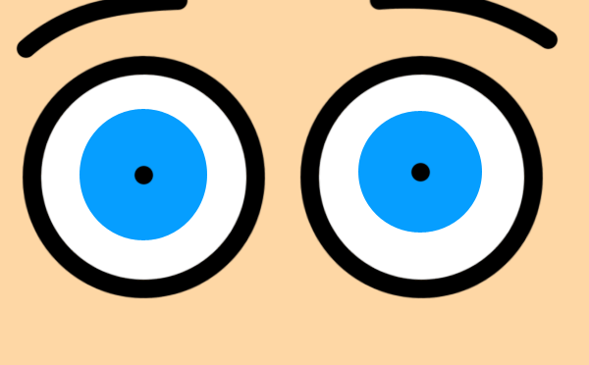
The Eyes
Our eyes allow us to see clearly. However, sometimes they can play tricks on us!

Slide 7
Our Eye Helps Us Memorize Things.
One way to memorize is to make a picture in our minds of what we are trying to remember.
You have one minute to memorize these objects.

Slide 8
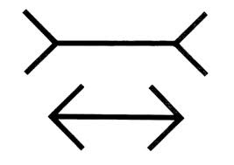
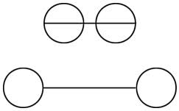
The Eyes
Which line is longer?
Which line is longer?
They are the same!

Slide 9
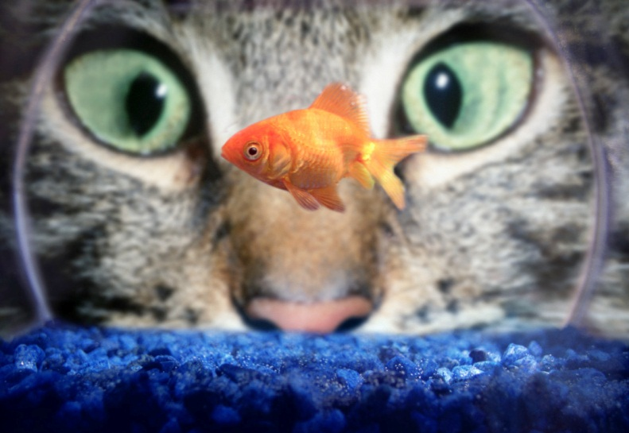
Dominant eye
* Everyone has a dominant eye. It can be your right eye
or your left eye.
* Our brain might get confused as to where an object actually is if we did not have a dominant eye.
How to find your dominant eye:
Pick out a vertical object or line in the distance e.g. a lamppost (outdoors) or the edge of a door or window (indoors).
Hold a finger or pencil vertically in front of you and line it up
with the vertical object.
Now close each eye in turn. What do you see?
Which eye do you think is the dominant one?
The eye which sees the finger or pencil in the same place as when your two eyes are open is the dominant one.

Slide 10
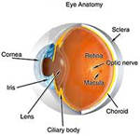
The blind spot of the eye
Every eye has a blind spot. This is where the optic nerve joins the retina of the eye.
You are not normally aware of this with two eyes as it does not happen at the same time with the two eyes!

Slide 11
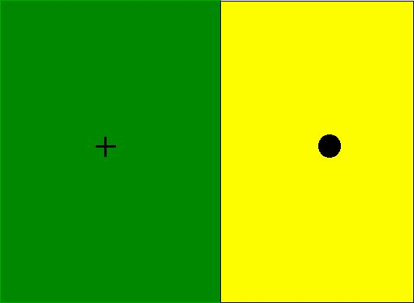
To discover the blind spot of your eye:
1. Make your own cross and spot diagram. Hold this page at arm’s length with the cross on the right.
2. Close your right eye.
3. While looking only at
the cross, bring the page
slowly towards your face.

Slide 12

What happens?
At a certain point the image of the spot will disappear because the light from it is falling on the blind spot of your left eye.

Slide 13

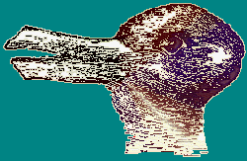
This Is a Bunny/duck Illusion. Do You See the Bunny and the Duck?

Slide 14
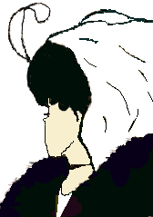
What do you see at first an old lady or a young woman?

Slide 15


Do You See a Vase, or Something More?

Slide 16

How Many Prongs Are on This Fork?

Slide 17

Find the Secret Message
Hint: Look at the White.

Slide 18
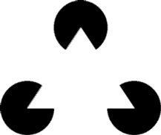
There Is Not a Triangle Here.

Slide 19
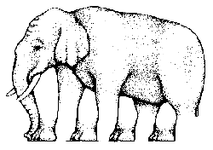
This Is a Dancing Elephant.
How Many Feet and Legs Does It Have?

Slide 20
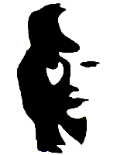
Is This Man Playing a Sax, or Is There Something More Going on Here?

Slide 21

What Does This Say?
Now Read It Again!

Slide 22
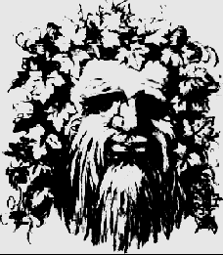
A Man With Ivy Leaves Around Him, but Do You See a Couple Kissing?

Slide 23
The nose is actually the girl’s face
The eyes of the old man are the hair for the boy and girl
The beard is the dress for the girl on the right and the clothes for
The boy on the left.

Slide 24
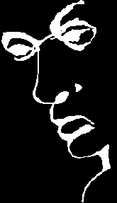
This Says the Word Liar, but Is There Something More?

