Slide 1
Spring Baby Animals

Slide 2
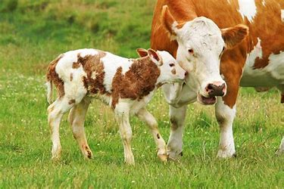
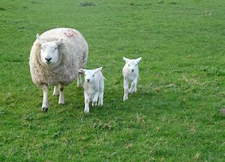
Farm Animals born in Spring
There are many baby animals born on a farm in Spring time. The two main ones are baby sheep that are called lambs and baby cows that are called calves.

Slide 3
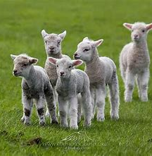
Baby Sheep – Lambs
Baby sheep are called Lambs. They are born on a farm in Spring time. It is best that they are born at this time as the weather isn’t cold like it would be in Winter.
Their mom is called a ‘ewe’.
Their mom will give them milk and that’s how they grow bigger and stronger.
When they are really small they will stay with their mom all the time but once they start getting bigger they will go and play with the other lambs.

Slide 4
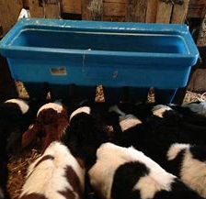
Baby Cows – Calves
Baby cows are called Calves. Like lambs, calves are born around spring as well.
Their mom is called a Cow.
If you see cows and calves in a field you might notice that they are all different. This just depends on the type of breed of the cow. This is the same as dogs – there are loads of different dog breeds and this is what causes them to look different.
Once a calf is born they are usually fed milk by the farmer.

