Slide 1
Spain
By Aoibhe and Eoin Kelly

Slide 2
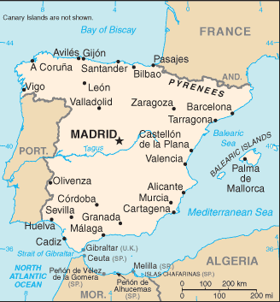
Where is Spain?
Spain is in Europe.
It is bordered by France and Portugal.
Africa is located to the south of Spain.
The Mediterranean sea and Atlantic Ocean surround Spain.

Slide 3
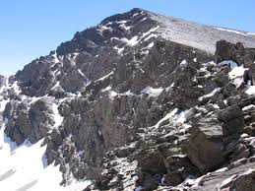
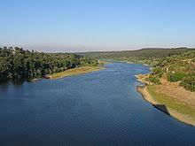
Physical Spain
Mulhacén is the highest mountain in Spain’s mainland.
The longest river flowing through Spain is River Tagus with a length of 1007km. It also flows into Portugal.

Slide 4
Spanish
Spanish is the fourth most language spoken in the world.
Countries such as Mexico, Argentina, Puerto Rico and Chile speak Spanish.
Here are a few basic words:
Hola (Hello)
Adiós (bye)
Gracias (thank you)

Slide 5
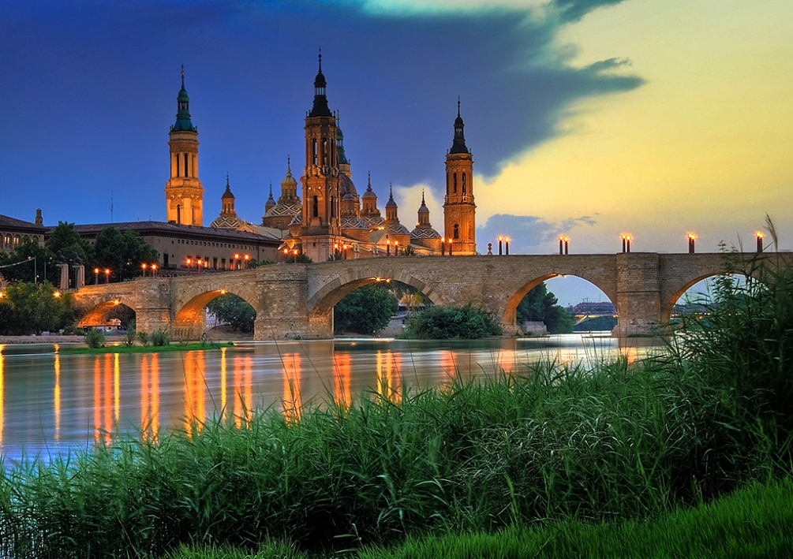
Interesting facts
https://youtu.be/0dIDdCUHcDs
Check out this video with facts about Spain.

Slide 6
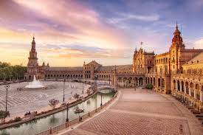
Tourism
Spain is a very popular holiday destination.
The Plaza de Espana is a popular tourist sight. It
is in the city of Seville. It is a semi circle brick
building with tall towers either side.

Slide 7
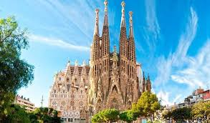
Sagrada Familia
The Sagrada Familia is a large, Roman Catholic
church in Barcelona. The building is still not
fully finished to this day.

Slide 8
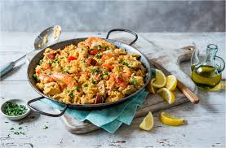
Food
Spain has many delicacies. Some such as Paella and Tortilla chips .
Paella is made up of white rice, chicken, vegetable and saffron.
Tortilla chips are made up of corn tortilla and cut into tryangles.

