Slide 2
When is Rosa Parks’ Day?
In California and Missouri, Rosa Parks Day is celebrated on the 4th of February.
In the states of Ohio and Oregon it is celebrated on the
1st of December.
The 4th of February is Rosa Parks’ birthday.
The 1st of December is the day that Rosa Parks was arrested.
This day was first celebrated in 2000 in California.
Can you find these states on a map of the America?

Slide 3
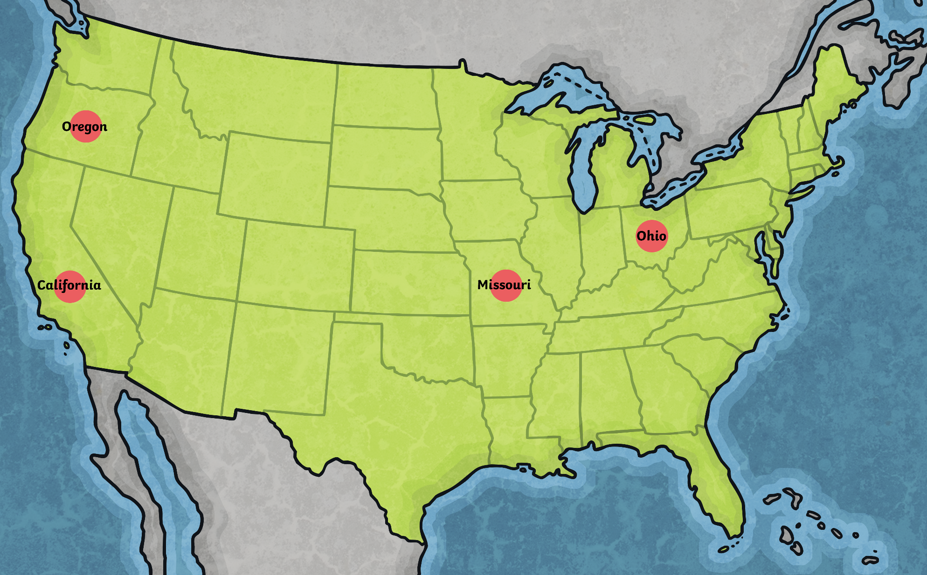

Slide 4
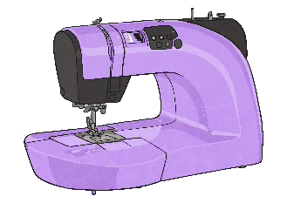
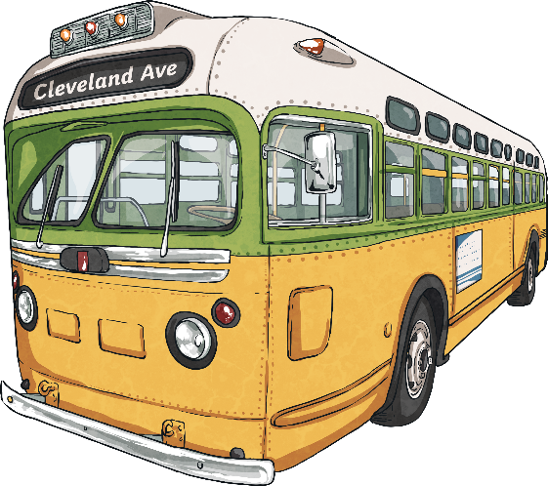
Who was Rosa Parks?
Rosa Parks worked as a seamstress.
She was the secretary of the Montgomery National Association for the Advancement of Coloured People. (NAACP)
The NAACP is a civil rights organisation in America which works towards the advancement of justice for African Americans.
Rosa Parks was arrested in 1955 in Montgomery, Alabama, for not giving up her seat on a bus for a white man.
This act by Rosa Parks was the beginning of Civil Rights history in the United States of America.

Slide 5
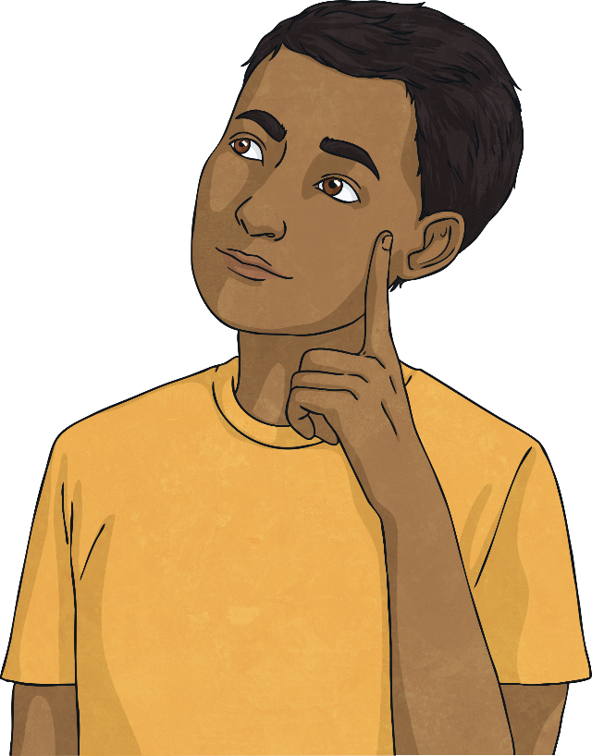
Why was Rosa Parks made to give up her seat?
During 1955 buses were segregated in Montgomery, Alabama.
This meant that African Americans were forced to sit at the back of the bus and were expected to give up their seats on buses for white people.
Public areas such as schools, transport, toilets and restaurants were also segregated.
This meant that there was a separate section for white people and black people.
White people were given priority of seats and were served in restaurants first.

Slide 6
The Bus Ride
Rosa Parks was on her way home from work on the 1st December 1955.
She was sitting in the section of the bus that was segregated for black people. The section for white people was full.
A white man got on the bus and Rosa Parks was told by the bus driver to give up her seat but she refused.
The bus driver called the police and Rosa Parks was arrested and charged. She had to pay a fine too.

Slide 7
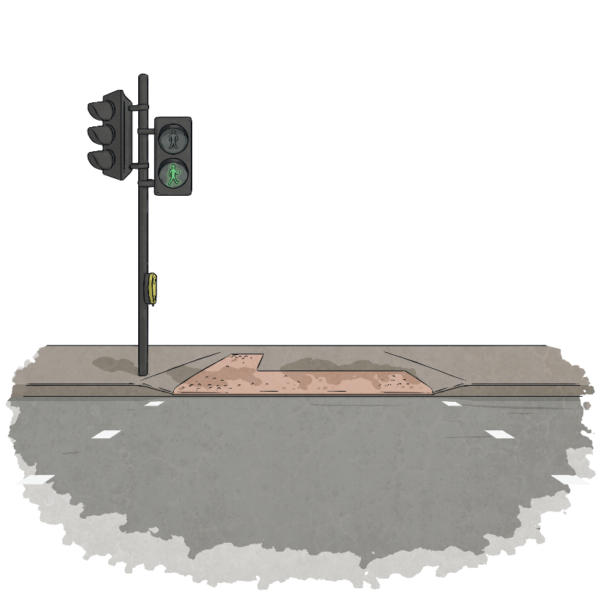
What Happened Next?
After this day 40,000 black people, and some white people, refused to use the buses in the area.
They said they would start using the buses again when they were treated fairly.
The action was known as the Montgomery Bus Boycott.
This lasted for 381 days.
The government stopped the segregation on buses.
This all happened because of Rosa Parks and her refusal to give up her seat.
This event was the start of the Civil Rights Movement in the USA.

Slide 8
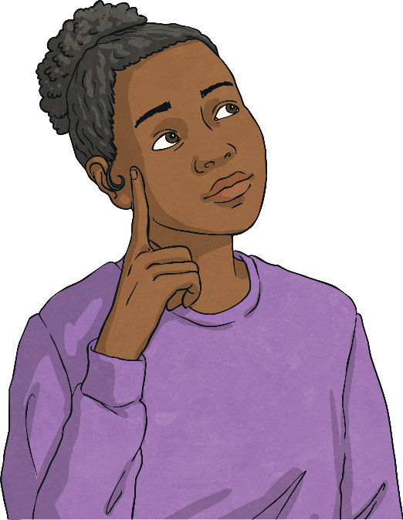
What Happened Next?
Rosa Parks was praised and respected for her actions years later.
She suffered as a consequence of her actions.
She was fired from her job as a seamstress.
Death threats were sent to her for years following the event.
Rosa Parks moved to Detroit after the boycott and got another job as a seamstress.

Slide 9
Did You Know…?
?
The name of the man driving the bus that day was James F. Blake.
12 years before she was arrested, Rosa Parks was not allowed to board a bus in the city.
?
She was ordered to board from the back door of the bus and then the bus driver drove off without her.
This bus was also driven by James F. Blake.
?
Rosa Parks said she would never ride a bus that was driven by him again.
She didn’t realise that he was driving the bus on December 1st 1955.

Slide 10
A quote from Rosa Parks’ autobiography; My Story
‘People always say that I didn't give up my seat because I was tired, but that isn't true. I was not tired physically, or no more tired than I usually was at the end of a working day. I was not old, although some people have an image of me as being old then. I was forty-two. No, the only tired I was, was tired of giving in.’

