Slide 2
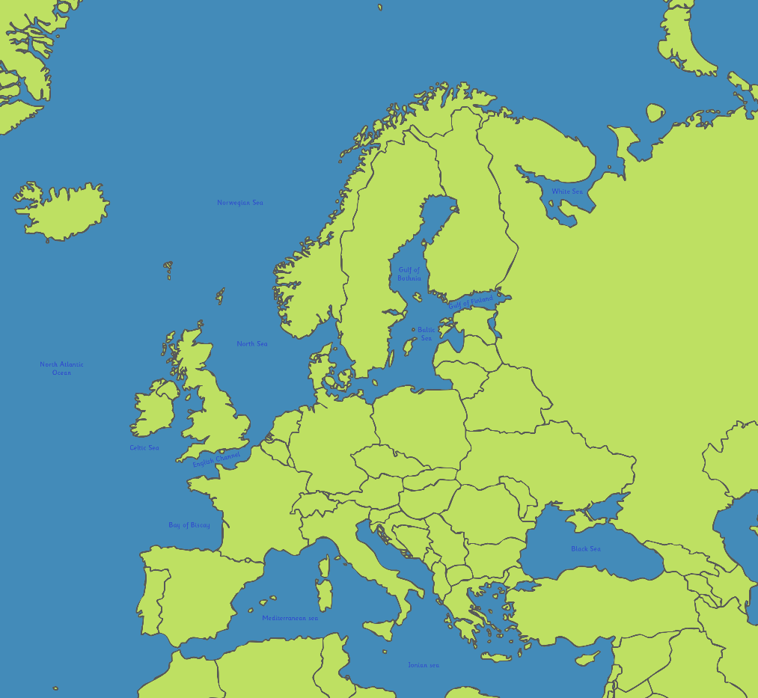
Where Is Poland?
Poland is a country in eastern Europe.
Poland shares borders with 7 countries: Russia, Lithuania, Belarus, Slovakia, Ukraine, the Czech Republic and Germany.
Poland

Slide 3
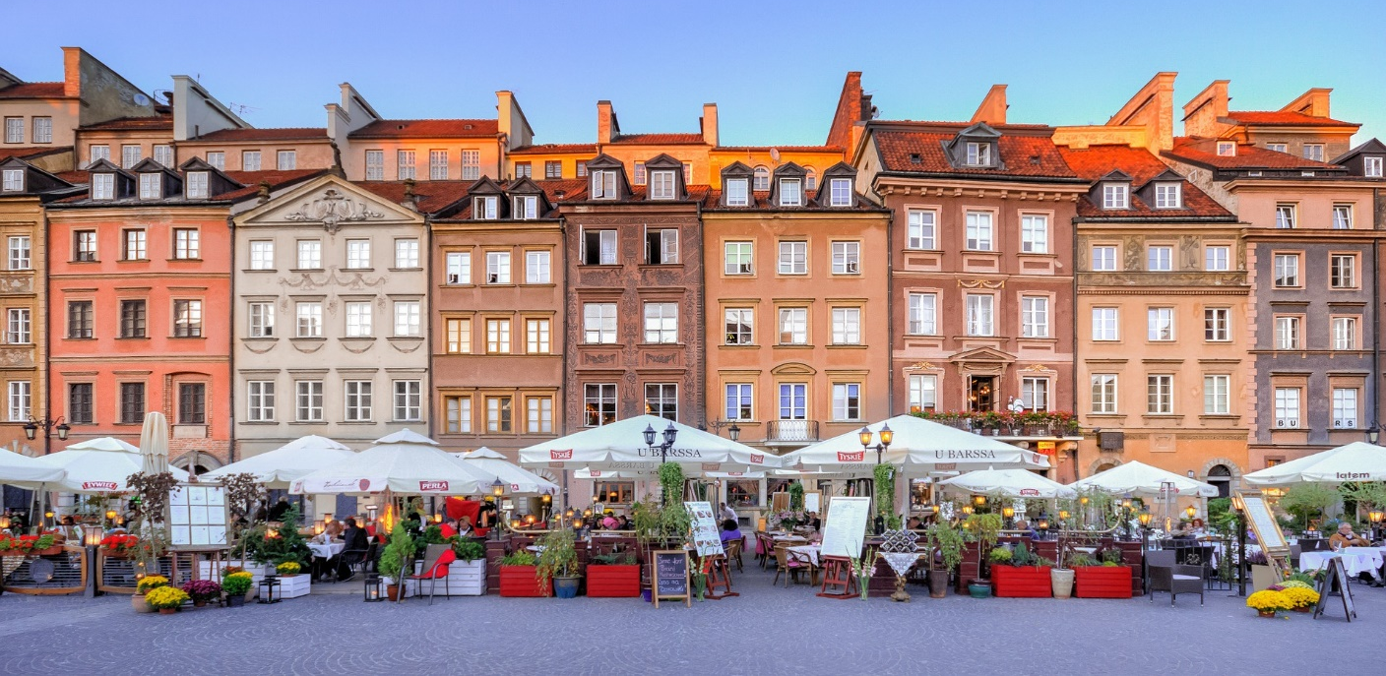
Facts About Poland
Its official name is the Republic of Poland.
The capital city of Poland is Warsaw.

Slide 4
Facts About Poland
Poland has a population of over 38 million people.
The prime minister of Poland is called Mateusz Morawiecki.
The currency is the Polish złoty.
The language spoken in Poland is Polish.

Slide 5
Some Polish Phrases
Hi
czesc pronounced ‘cheshch’.
Bye
czesc pronounced ‘cheshch’.
See you
do widzenia pronounced ‘doh vidsenya’.
Yes
tak pronounced ‘tahk’.
No
nie pronounced ‘nye’.
Please
prosze pronounced ‘prosheh’.
Thank you
dziekuje pronounced ‘dsyenkooyeh’.

Slide 6
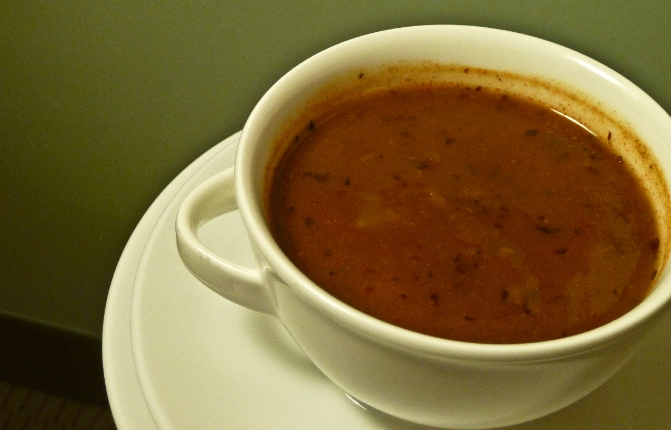
Polish Food
Polish food is a mixture of different cultural traditions. It is based quite heavily on meats, noodles, spices and dumplings.
A famous soup there is called flaczki or tripe soup.
“Polish Soup” by [UggBoy UggGirl] is licensed under CC BY 2.0

Slide 7
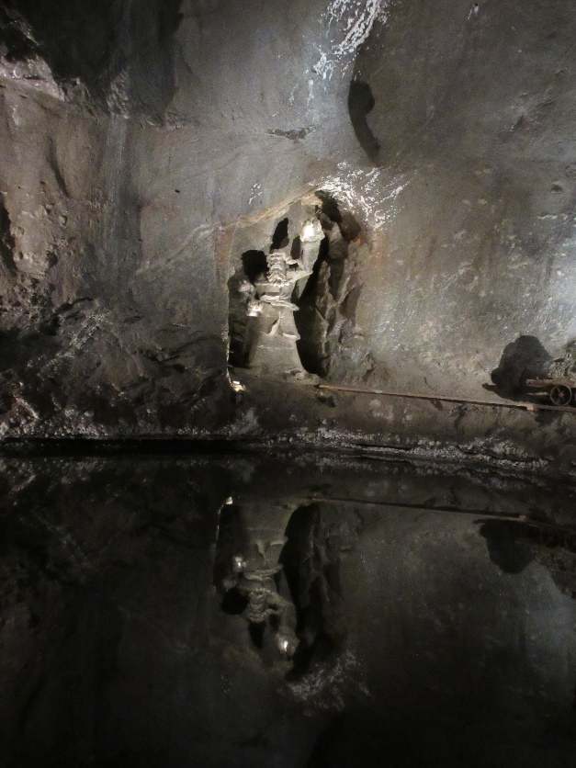
Wieliczka Salt Mine
The Wieliczka Salt Mine is in the town of Wieliczka.
It is made up of lots of underground caves and tunnels made from salt and visitors can go there to take tours around it.
It even has four chapels inside and an underground lake!
“Wieliczka Salt Mine” by [NH53] is licensed under CC BY 2.0

Slide 8
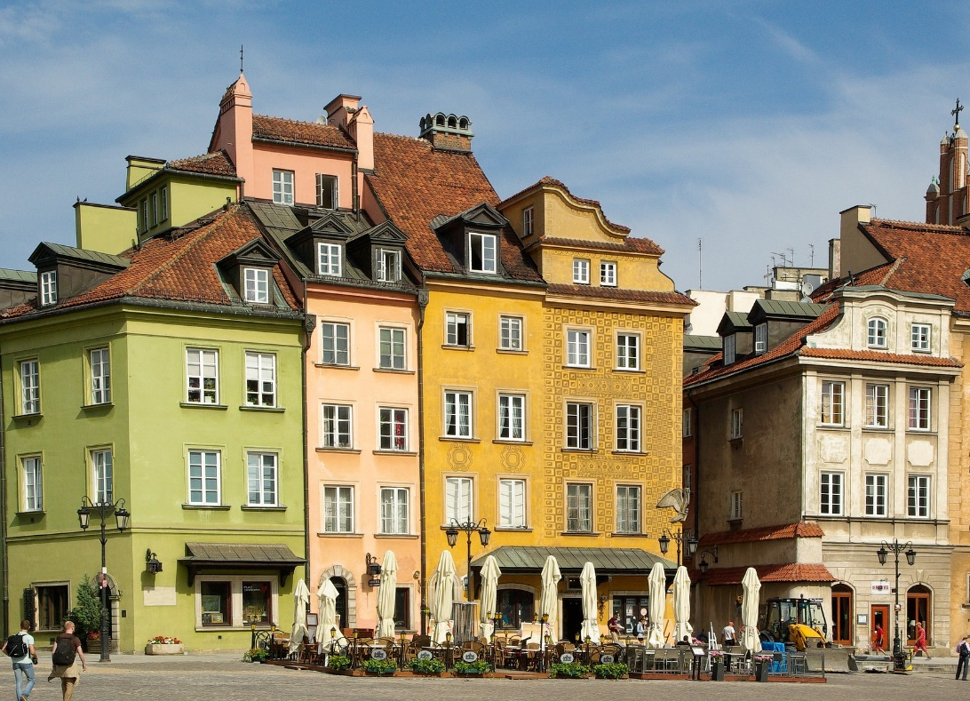
Warsaw Old Town
The Old Town is the oldest part of Warsaw. It is a big tourist attraction in Poland.
This area has a large pedestrianised section to wander around with lots of lovely restaurants, shops and cafés.
There is a lot of medieval architecture to be seen around here, such as the city walls and St. John’s Cathedral.

