Slide 1
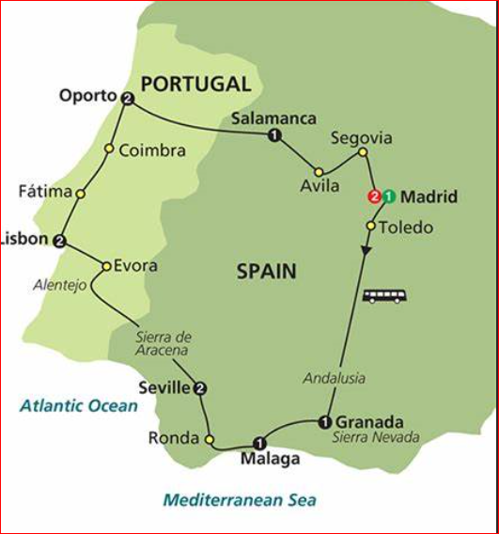
Portugal
Clara Murphy

Slide 2
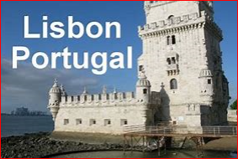
Portugal is in Europe
It is on the west coast of the Penninsula called Iberia which it shares with Spain
The people here do not speak Spanish but they speak Portuguese. My 2nd Cousin is half Portuguese. Her name is Mia and she is 1 and ½.
Portugal looks out onto The Atlantic Ocean to the West of the Country
The Capital of Portugal is Lisbon

Slide 3
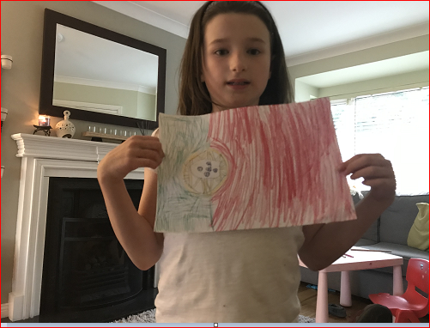
Here is a picture of the flag I drew of Portugal

Slide 4
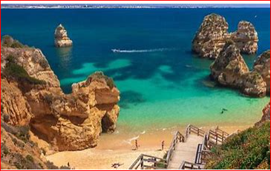
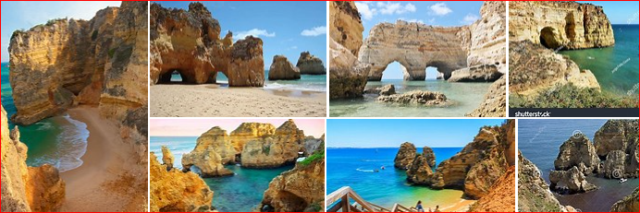
Tourism
Portugal is famous for its nice beaches, structured cliffs and pillars and Surfing.
Portugal have about 23 million visitors a year.

Slide 5
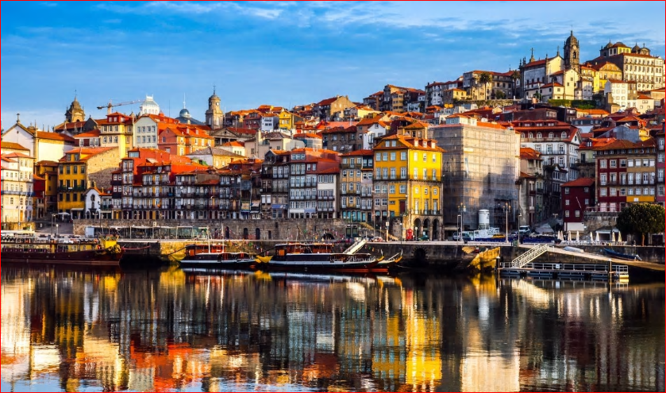
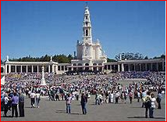
Some attractions of Portugal are beautiful towns like Porto
There is a famous town called Fatima in Portugal.
A long time ago, it is believed that Holy Mary appeared to children in Fatima and it is a place of worship for many tourists.

Slide 6
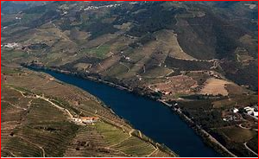
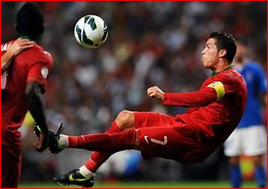
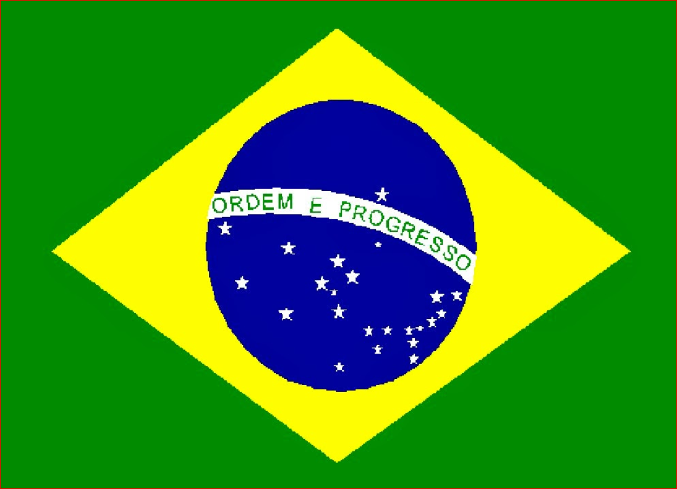
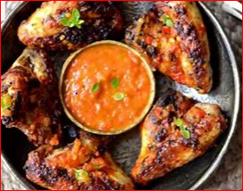
Some Fun Facts
Famous Footballer Ronaldo who played for Manchester United and Portugal comes from Madeira in Portugal.
The longest river in Portugal is the Tagus
The food Piri Piri originates from Portugal
Portuguese is also spoken in Brazil.

Slide 7
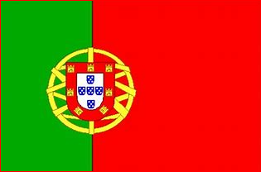
The End
Good bye……..
Até Logo

