Slide 2
Challenge 1
Find 5 vertical lines in the room.
Find 5 horizontal lines in the room.
Find 3 oblique (diagonal) lines in the room.

Slide 3
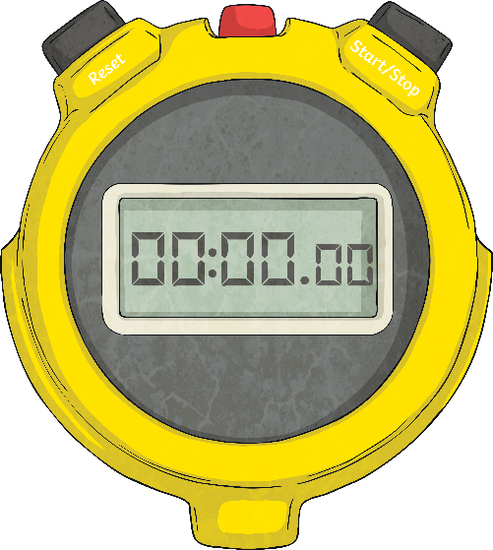
Challenge 2
As a whole class, can you
skip count in 2s up
to 50 in 20 seconds or less?

Slide 4
Challenge 3
What time is it now?
What time will it be in 2 hours?
1
What time was it 3 hours ago?
_
2
What time did you start school work today?
What will you be finished school work today?

Slide 5
Challenge 4
How many apples would you need to be able to give everyone in your class 3 apples?
Each chocolate bar has six pieces.
How many chocolate bars would you need to have to make sure everyone in your class got 2 pieces?

Slide 6
Challenge 5
What shapes can you see in this picture?
How many of each shape can you see?

Slide 7
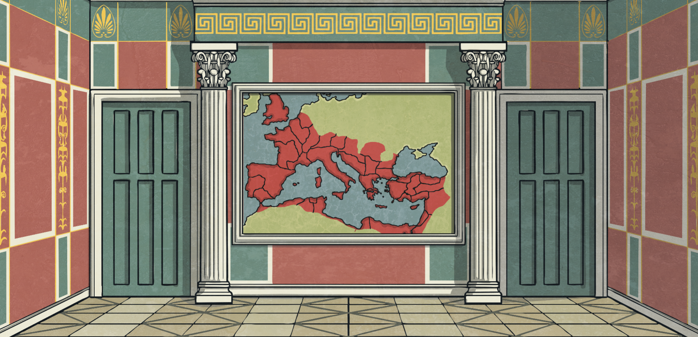
Challenge 6
What shapes can you see in this picture?
How many of each shape can you see?

Slide 8
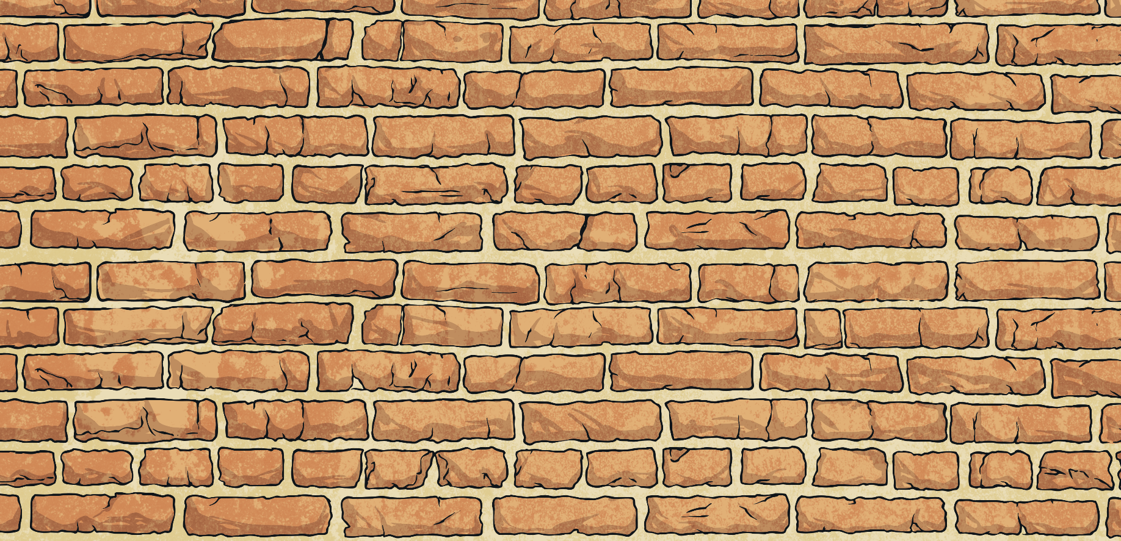
Challenge 7
How many full bricks did the builder use to build this wall?

Slide 9
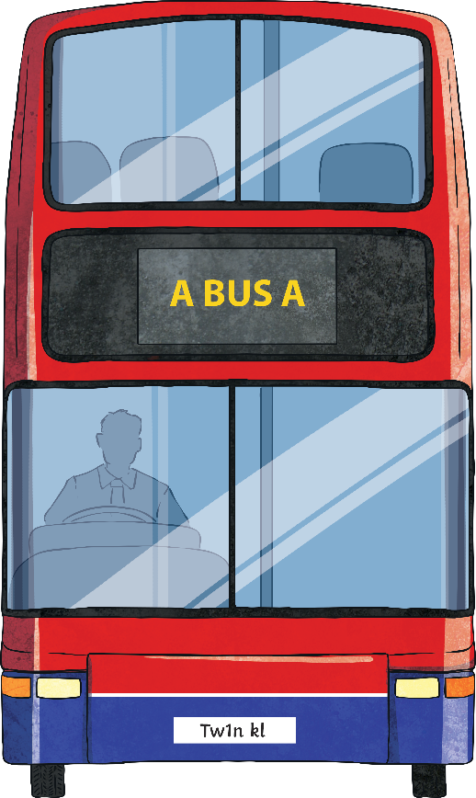
Challenge 8
25 people can sit on the bottom deck and 39 people can sit on the top deck. There are 300 children in River View National School.
How many buses will they need to bring the whole school on a school trip?

Slide 10
Challenge 9
Find an example of each of these shapes in your classroom.

Slide 11
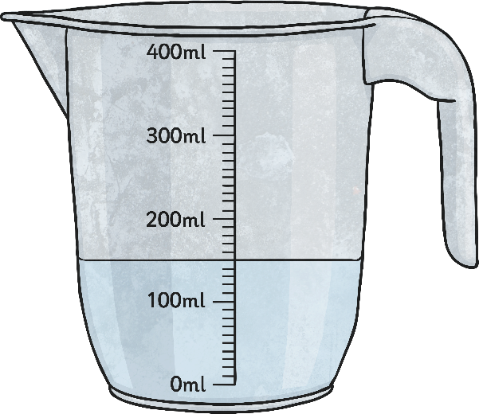
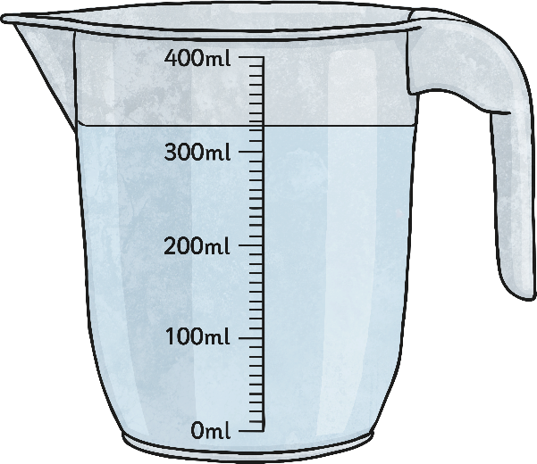
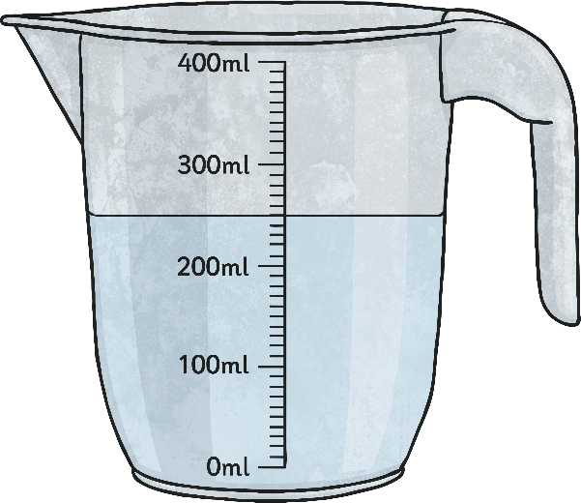
Challenge 10
Which of these, do you think, holds the most liquid?

