Slide 1
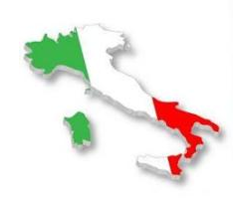
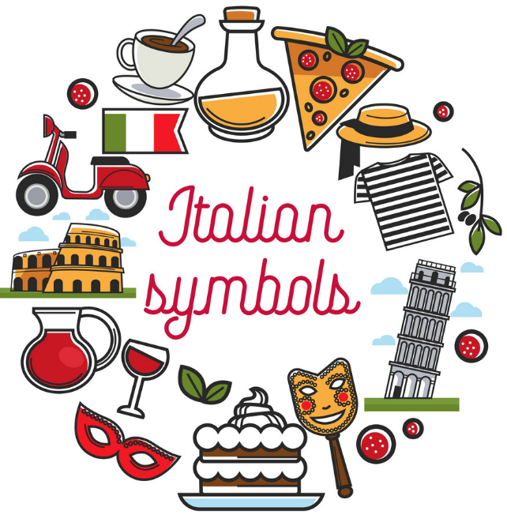
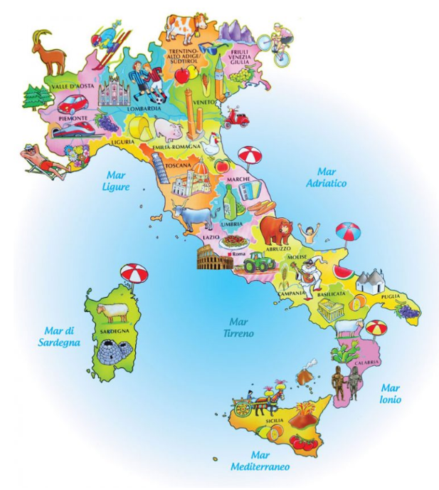
ITALY
Kacper Galus

Slide 2
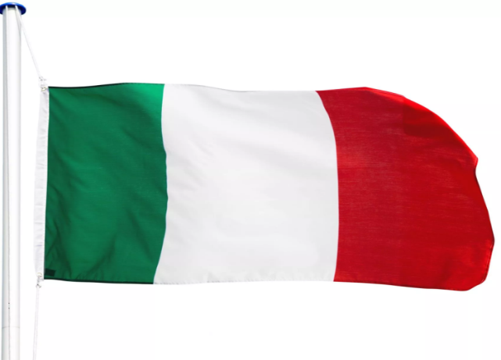
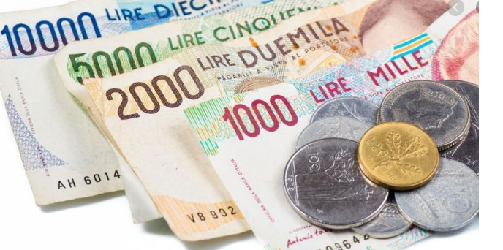
FACTS ABOUT ITALY
Capital: Roma (Rome), which is often called 'Eternal City‚
Name: Repubblica Italiana (Italian Republic) or simply: Italia, Nickname: 'Bel Paese' which means beautiful country
Language: Italian as well as German
Government: Democracy, Republic
Currency: 1 Euro = 100 cents, before 2001: Italian Lira
Flag:
National Symbols: Italian grey wolf (national animal), red rose or white lily (national flowers) and the white five-pointed star with a red border

Slide 3
INTERESTING FACTS
Italy's largest island is Sicily.
The biggest city of the country is Rome with 2.9 million people.
The highest mountain peak in Italy is Monte Bianco, better known as Mont Blanc, which is 4 807 m or 15 776 ft. high
Lake Garda is the largest lake in Italy.
The Etna is the most active volcano in Europe.

Slide 4
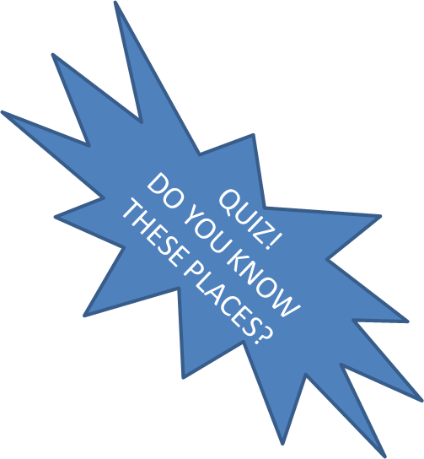
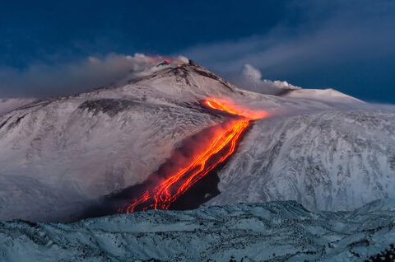
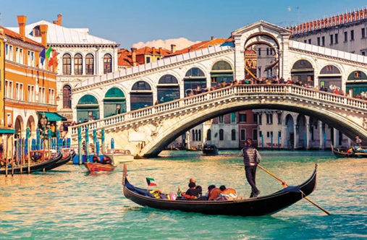

Slide 5
FOOD
Pizza is surely one of the most famous exports and in Italy it is usually baked in a wood-fired oven and very thin, but loaded with fresh vegetables or thinly sliced ham, salami, artichokes or olives. The Italian pasta is renowned worldwide and there are more than 200 different shapes.
Here is some typical Italian food:
Pizza: probably the most famous Italian dish, it was invented in Napoli/Naples around 1860
Calzone: folded up pizza bread filled with tomatoes, ham, cheese and all kinds of filling
Pesto: thick green sauce with olives, herbs and olive oil, pine kernels and parmiggiano cheese. Healthy and mmmmh!
Gelato: ice-cream is an Italian invention
Lasagna: layered pasta dish with tomato, mozzarella cheese and mince meat filling.

Slide 6
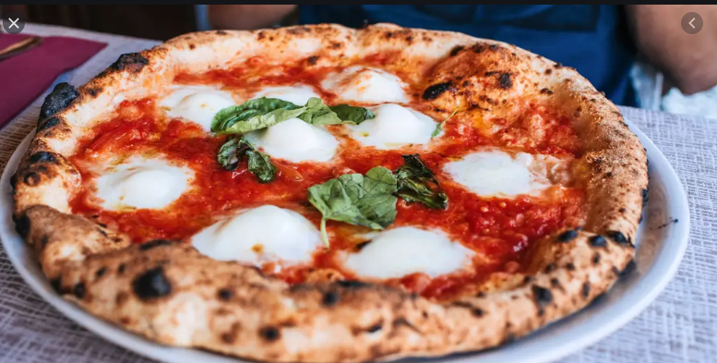
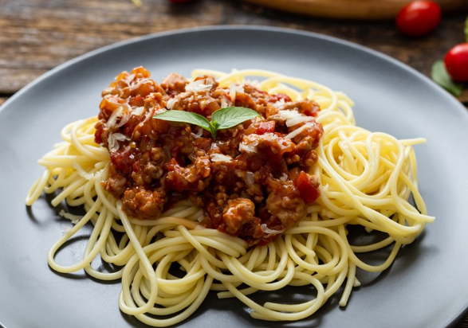
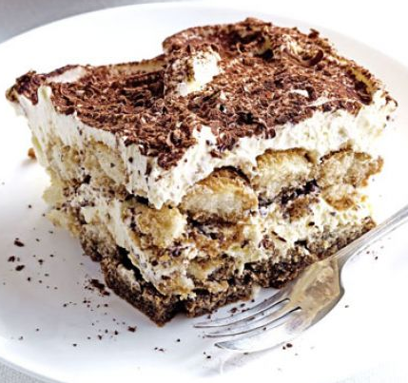
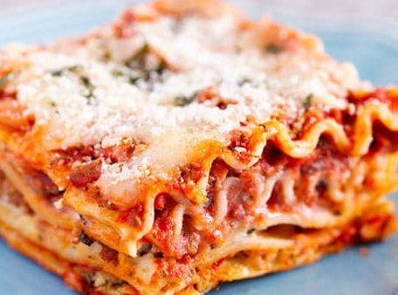
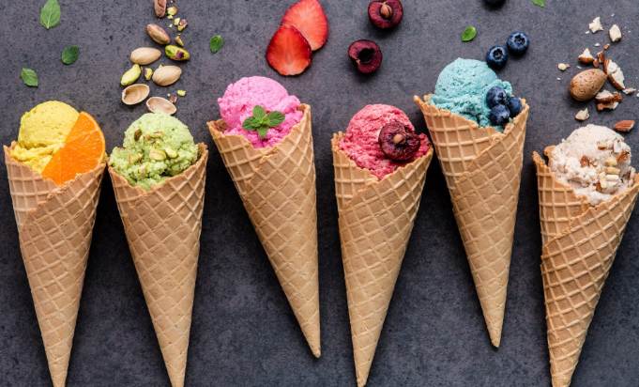
QUIZ: DO YOU KNOW TYPICAL ITALIAN FOOD?
QUIZ TIME ☺

Slide 7
FAMOUS PEOPLE
Italians are famous for their inventions and discoveries. The Italian explorers Christopher Columbus and Amerigo Vespucci discovered the Americas while Marco Polo explored the East.
Leonardo da Vinci was a scientist and artist who was the first to prove the world is round and not flat.
Alessandro Volta, was the pioneer who did studies in electricity, hence the name 'Volt' describing a unit of electricity.

Slide 8
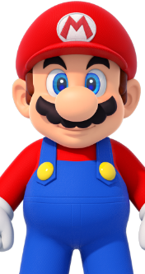
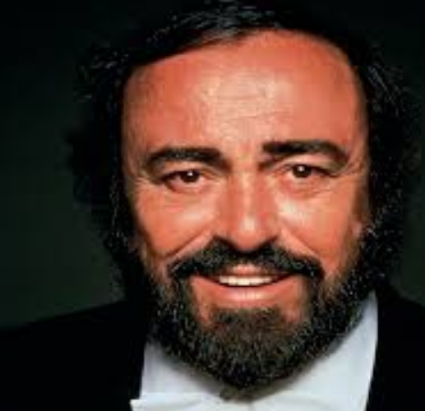
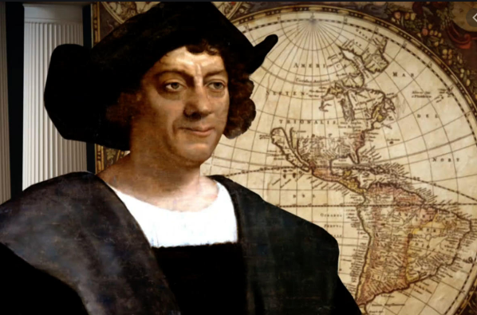
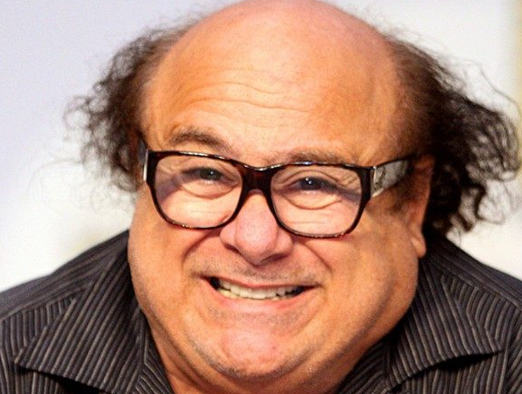
Do you know these people?
QUIZ TIME ☺

Slide 9
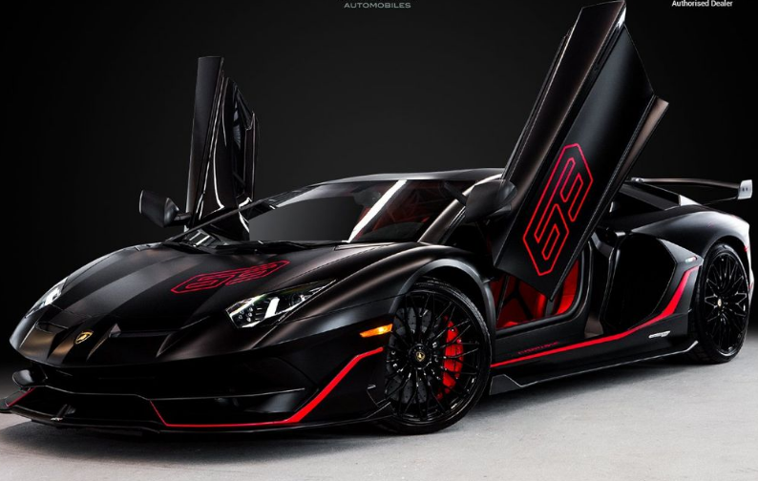
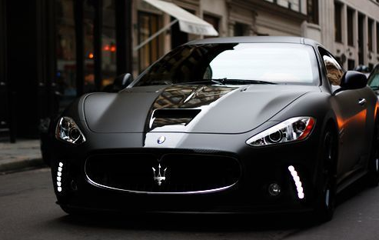
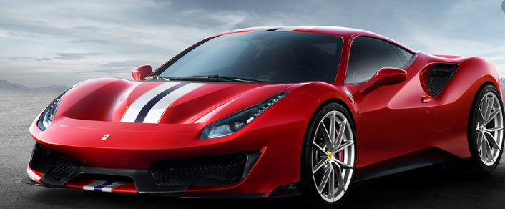
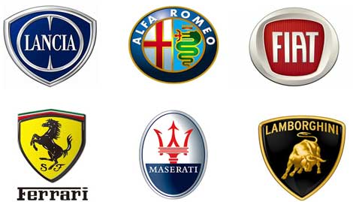
FAMOUS ITALIAN CARS
Lamborghini
Maserati
Ferrari

Slide 10
ITALIAN CUSTOMS AND TRADITIONS
In Venice Italians celebrate Carnivale di Venezia, a two-week party in early spring. It is marked by parties, parades, live performances of music and, most famously, masquerade balls.
Erragosto is an Italian summer holiday. Traditionally, it was simply a period of relaxation; in fact, Italians used to take the entire month of August off as a vacation.

Slide 11
LANGUAGE
10 useful Italian words and terms
ciao - hello
grazie - thank you
prego - please, you are welcome
bene - good
come stai? - how are you? (informal, with family and friends)
si - yes
no - no
scusami - excuse me
ho fame - I am hungry
ho sete - I am thirsty

Slide 12
THANK YOU GRAZIE

