Slide 1
ITALY
By William Whelan

Slide 2
ITALY Facts
Population: Around 60 million
Borders: France, Switzerland, Austria
Currency: Euro
Language: Italian
Best known for: Art, architecture, fashion, food

Slide 3
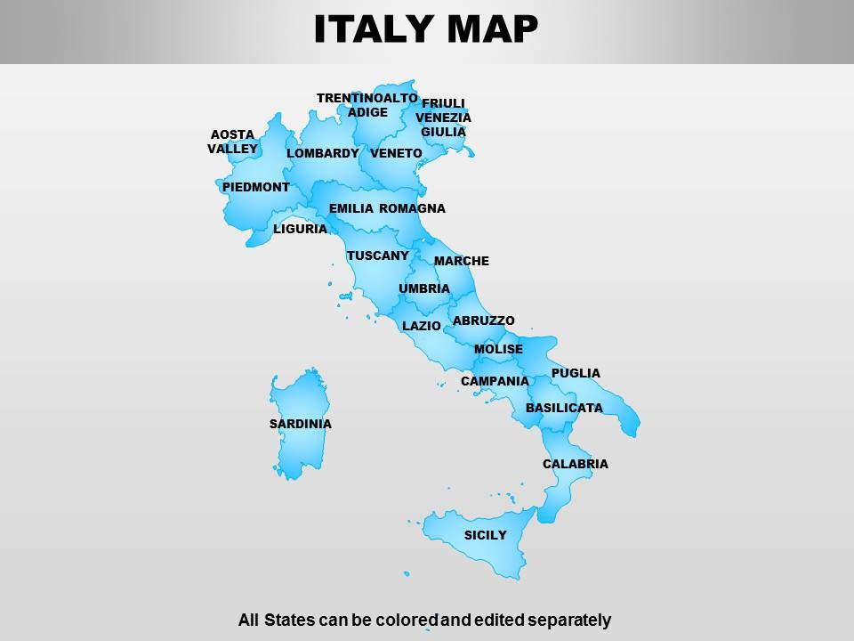
Map of Italy
The map of Italy looks like one of my football boots!!

Slide 4
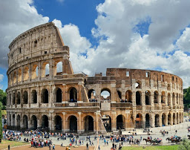
Famous Italian Landmarks
Colosseum
Famous arena in Rome where gladiators fought

Slide 5
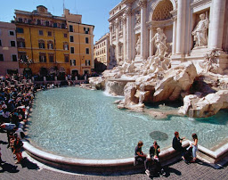
Trevi Fountain
Famous 18th century fountain in Rome

Slide 6
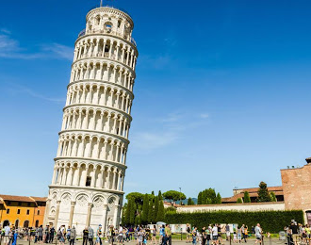
Leaning Tower of Pisa
The tower I think is falling over!

Slide 7
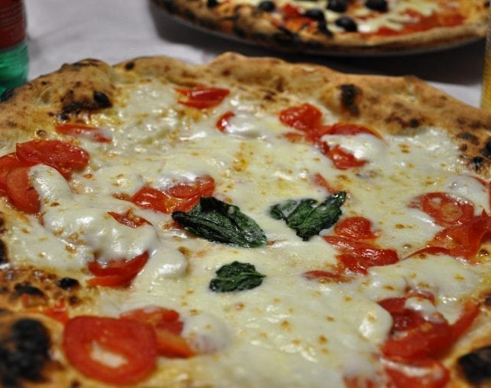
Famous Italian Food
PIZZA
As you can see from the Margherita pizza it has the same colours as the flag of Italy!

Slide 8
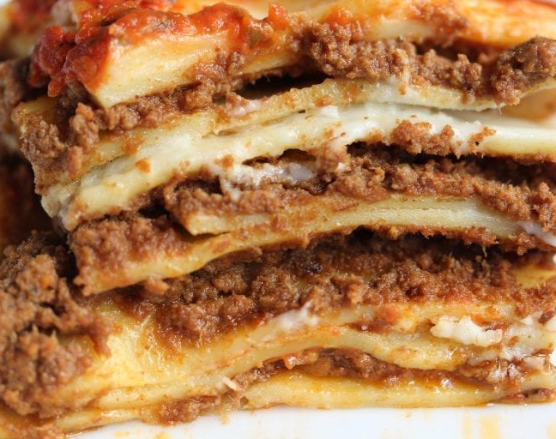
Lasagne
Lasagne is an Italian dish made up of layers of flat pasta with meat and tomato sauce inside, delicious!

Slide 9
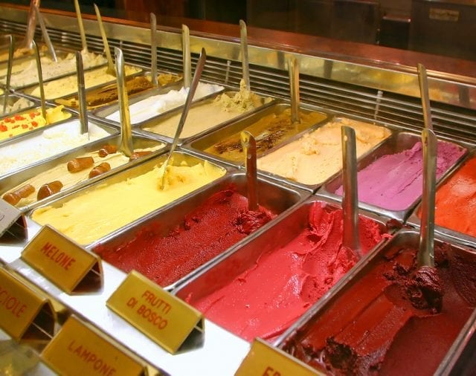
Gelato
Italians love Gelato because it is low in fat compared to normal ice-cream that we eat so you can eat as much as you want -)

Slide 10
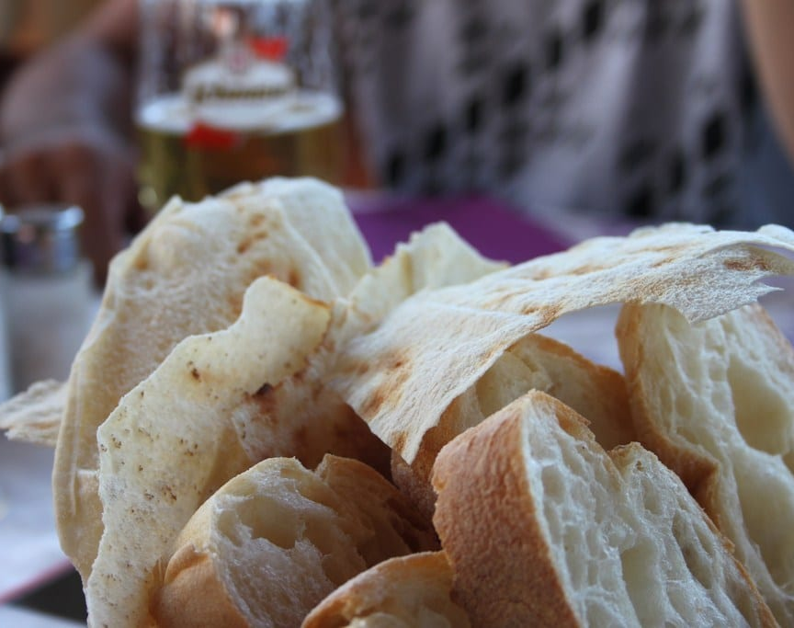
Bread
There are hundreds of different types of bread in Italy. Focaccia and Ciabatta are type of Italian bread.

