Slide 2
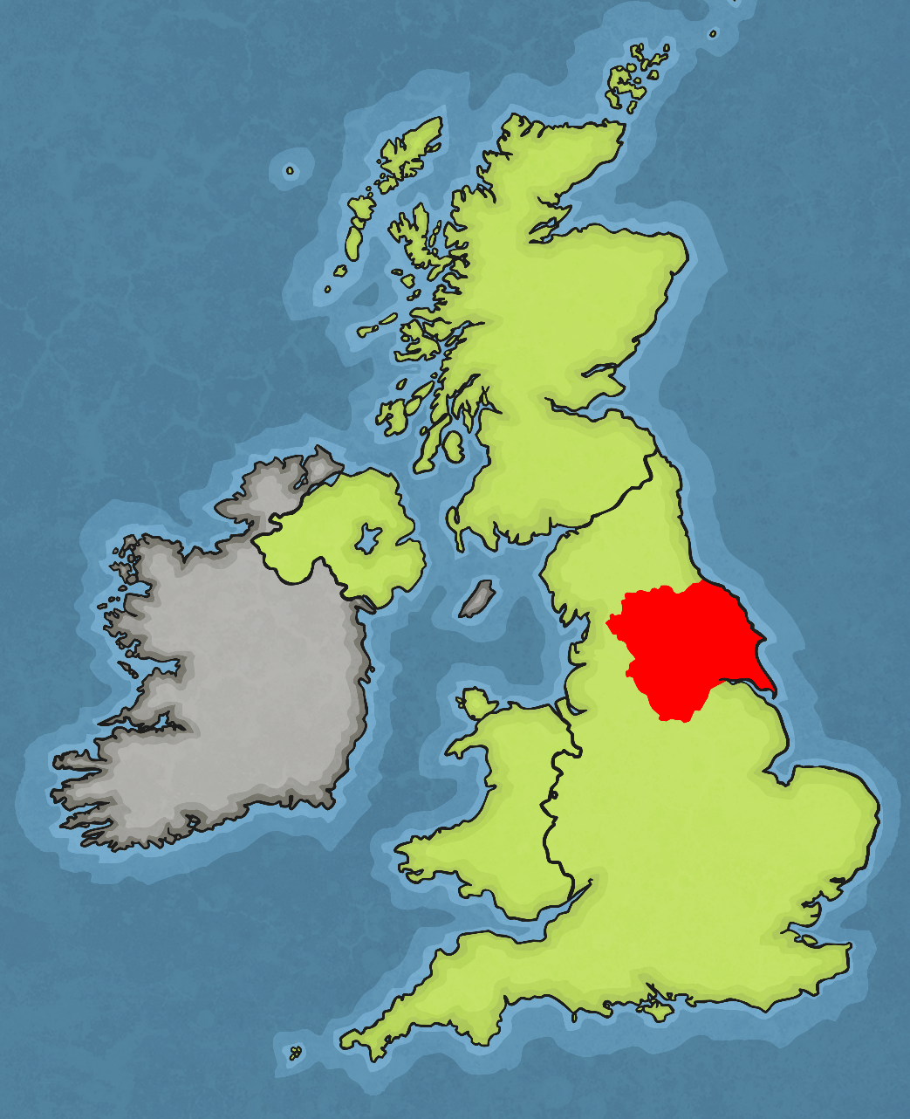
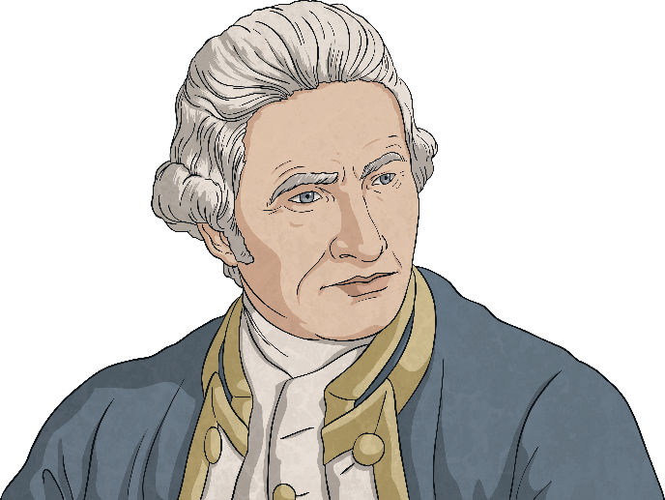
Captain James Cook was born on 7th November, 1728.
He was born in a small village called Marton, Yorkshire.
Yorkshire
His father was a farmer and he grew up on the farm.
However, he was very interested in the sea and travelling on the seas.

Slide 3
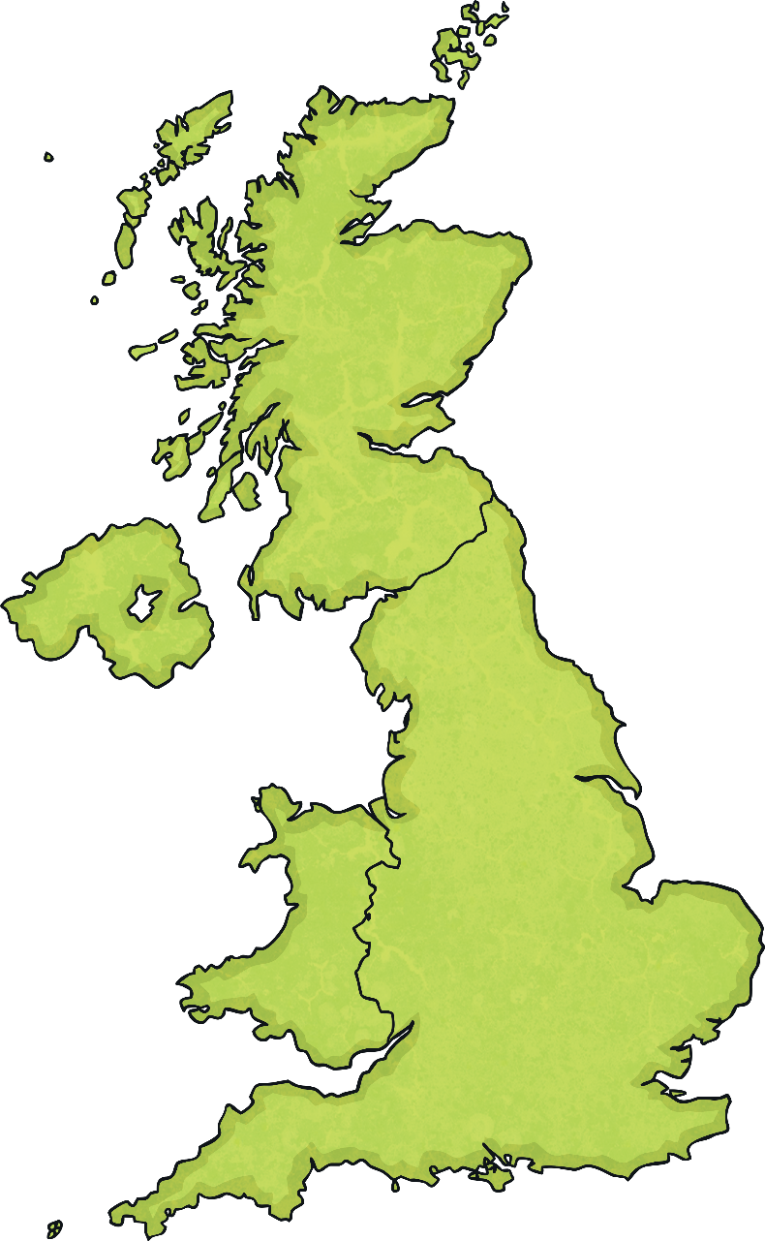
When he was 17, he moved to the coast in Whitby, North Yorkshire.
Here he got a job as a coal merchant, working on the ships transporting coal from the River Tyne to the River Thames.
Can anyone point out the River Tyne
or the River Thames?
River Tyne
River Thames

Slide 4
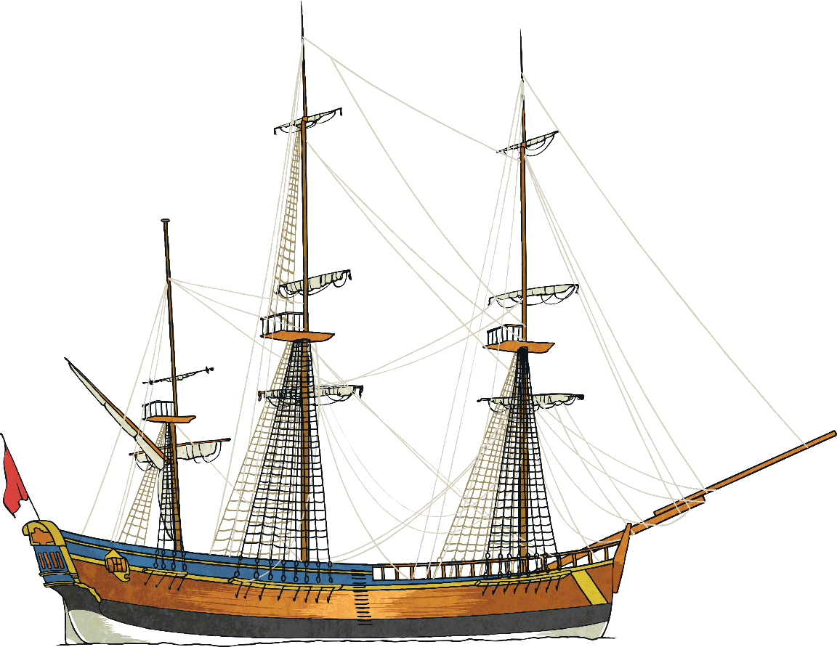
During his time as a coal merchant, he demonstrated excellent sailing skills. He also had a great interest in astronomy. In 1755, he joined the Royal Navy and he learned how to sail. He also developed his skills in making maps, and was so good that, in 1768 and at the age of 40, he was promoted to commander of a ship called the HMS Endeavour.
HMS Endeavour
368 tonnes
32 metres long
Crew of 94
Departed from the port of Plymouth, England on 26th August 1768.

Slide 5
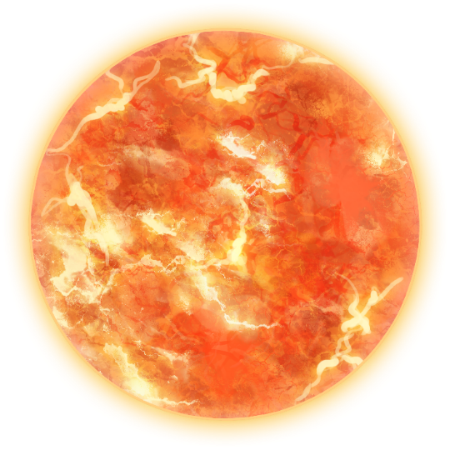
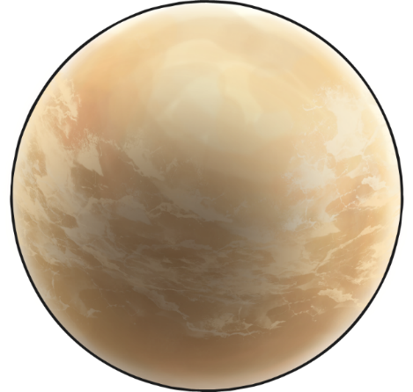
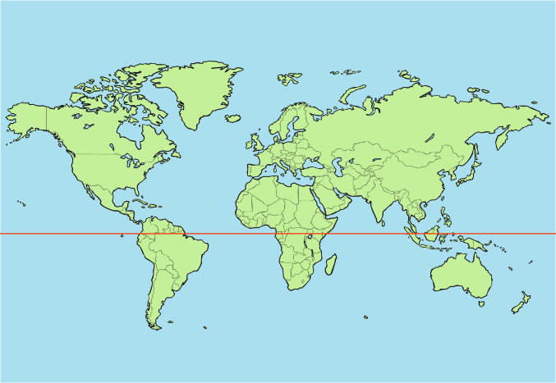
In 1769, the planet Venus was due to pass in front of the Sun, a rare event visible only in the southern hemisphere. The British government sent an expedition to observe this event and as commander of HMS Endeavour, Cook led this expedition.
What is the southern hemisphere?
The southern hemisphere is the half of planet Earth that is below the equator.
southern hemisphere
equator

Slide 6
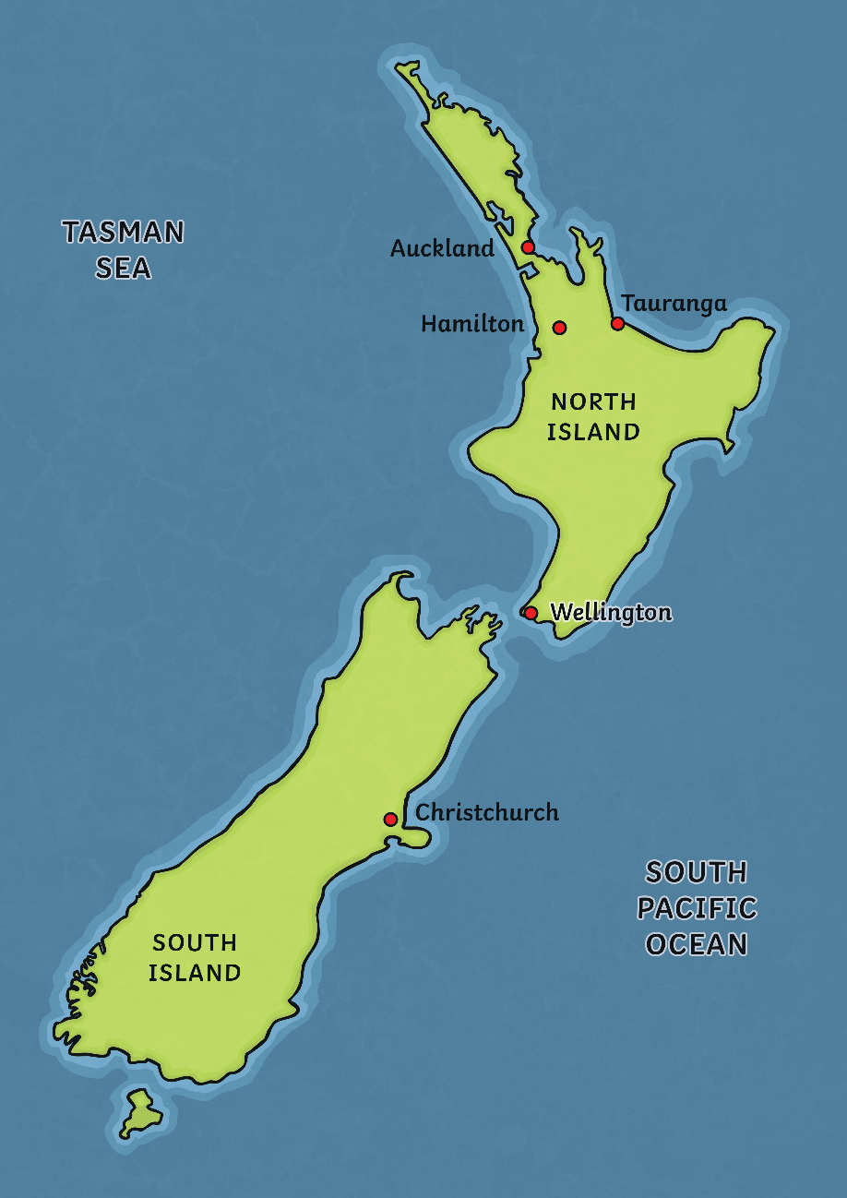
Having observed the transit of Venus in Tahiti, the Endeavour and her crew sailed south to explore new, uncharted waters. Cook promised his crew that the first person to see the new land would have that area named after them.
Cook Strait
It was on 6th October 1769 when the 12 year old surgeon’s assistant named Nicholas Young, spotted land on the horizon. It was a headland on the east coast of the North Island of New Zealand.
As promised, this headland became known as Young Nick’s Head.
Young
Nick’s
Head

Slide 7
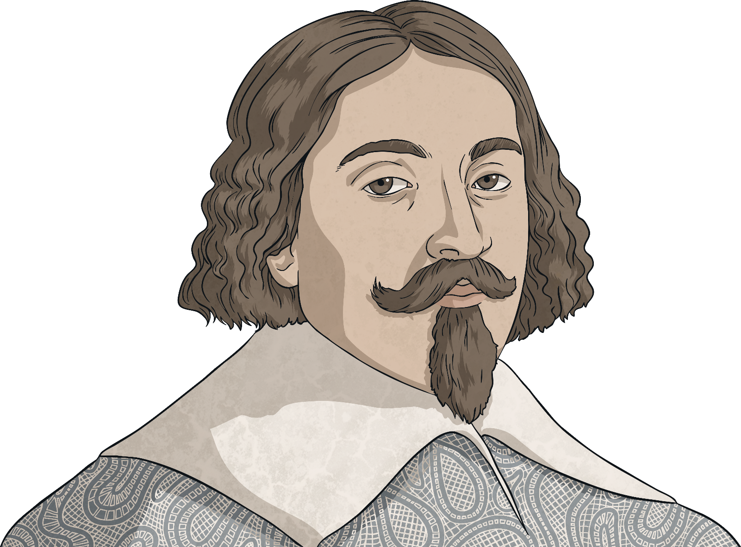
Charting New Zealand
Cook spent the next few months mapping out the North Island, then the South Island. On 15th January 1770, Cook anchored the Endeavour at Ship Cove at the top of the South Island.
He observed the narrow channel of water between the islands that is now known as Cook Strait.
Not the First
127 years before Cook’s arrival, in
December 1642, a Dutch explorer
named Abel Tasman had been the
first European to discover what
would later be called Tasmania.
He also sighted New Zealand
but bad weather prevented
further exploration.

Slide 8
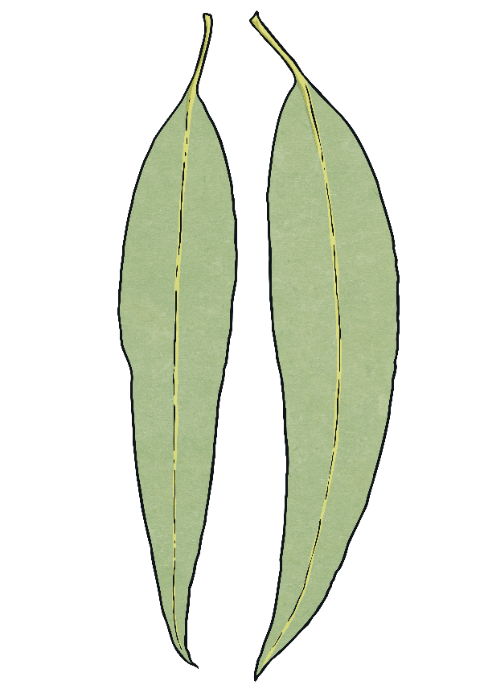
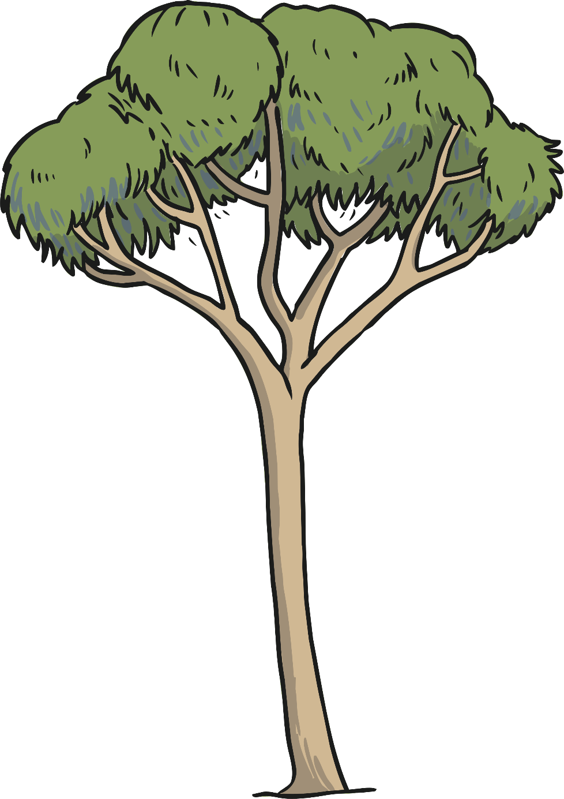
On the voyage with Cook were also two botanists and collectors, Joseph Banks and Daniel Solander. Their job was to study and record the plants and animals that they discovered in New Zealand and Australia.
Together, they collected over 1000 plant species that were previously unknown in Europe. For example, eucalyptus, acacia and banksia (which was named after Banks).

Slide 9
Cook and his crew sailed to the Pacific Ocean and watched the planet Venus pass across the Sun.
In April 1770, they spotted the east coast of Australia, the first Europeans ever to do so.
They continued to sail along the Australian coast and eventually set foot on land in Australia at Botany Bay. They claimed it as British territory and named it ‘New South Wales’.
Australia
Botany Bay
Why do you think they might have called it this?
At the time, early Dutch explorers who first spotted Australia had referred to the land as New Holland. Cook was the first European to see the southeast coast of Australia and so wanted to give it a name to distinguish it from the rest of New Holland. New England had already been used elsewhere.

Slide 10
After they had claimed Australia, they sailed north along the coast.
They were almost shipwrecked along the Great Barrier Reef due to rough weather conditions, however they were able to sail into what is now called Cooktown (after Captain Cook) in North Queensland, where they repaired the ship.
They returned home to England in 1771, having sailed over 30,000 miles and charted over 5000 miles of coastline. Cook used all this information to tell people about everything he had discovered and became very famous.
Cooktown
Queensland
Australia
Botany Bay

Slide 11
In 1772, not satisfied by his previous expeditions, Cook set out on a second voyage to discover more about the Pacific Ocean. He wanted to know if there was a huge continent to the east of New Zealand. Returning to New Zealand and using it as a base, he sailed east and then south into unexplored ocean. This second voyage confirmed that there was no great continent and they returned to England in 1775.
Can you find New Zealand on this map?
Cook’s third voyage (1776-1779) was to discover the North-West Passage, which was thought to link the Atlantic and Pacific Oceans. However, they were unable to find this area and sailed south to explore the island of Hawaii.
Australia
New Zealand

Slide 12
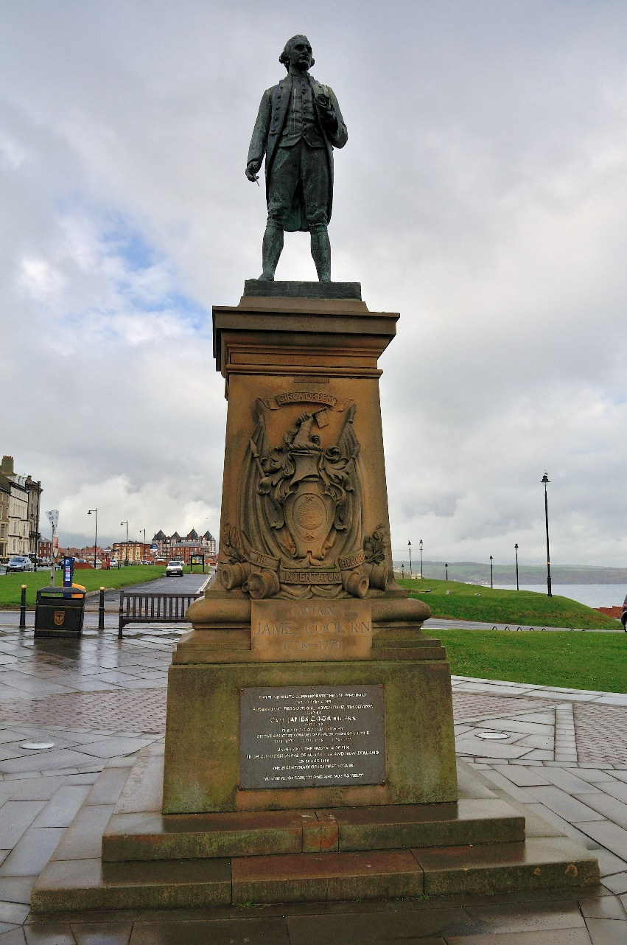
This third voyage was to be Cook’s last.
On 14th February 1779, he was involved in a dispute with a Hawaiian tribe and was captured and killed. When Cook’s crew found him, they buried him at sea.
Captain Cook is considered one of the world’s greatest explorers and was the first person to create an accurate map of the Pacific Ocean.
Statue of Captain James Cook in Whitby, Yorkshire.
Photo courtesy of (Philip N Young@Flickr.com) – granted under creative commons licence

