Slide 1
Gaeilge
18-22 Bealtaine

Slide 2
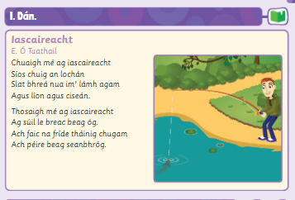
Dán- Iascaireacht
Click to listen to the dán being read as Gaeilge.
Click to listen to the dán being read as Béarla .

Slide 3
Foclóir Nua
Click to listen to foclóir.
Click to listen to new phrases.
1. Taitníonn _________ go mór liom.
2. Tá suim mhór agam sa _______.

Slide 4
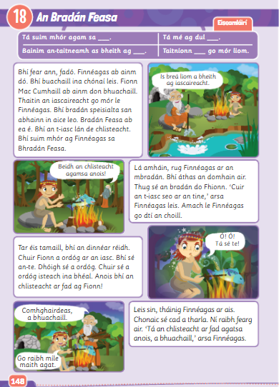
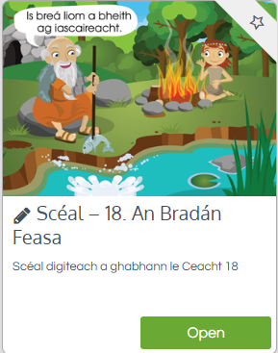
Scéal: Bradán Feasa
Listen to the scéal online being read or
Look at lch 148 and click to listen to the scéal being read and translated.
Try and read the scéal yourself!

Slide 5
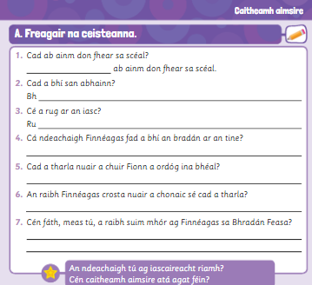
Freagair na ceisteanna
Click to listen to the questions being read and translated.
Answer the questions.
Freagair na ceistenna as gaeilge. (Go back and look at the text to do this.)

Slide 6
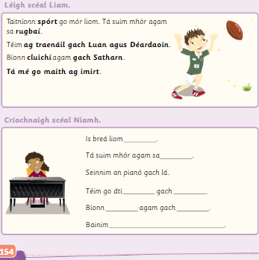
Scéal Liam agus Niamh
Click to listen to scéal Liam and scéal Niamh.

